Slide 1
HIGH VISION
Satungal

Slide 2
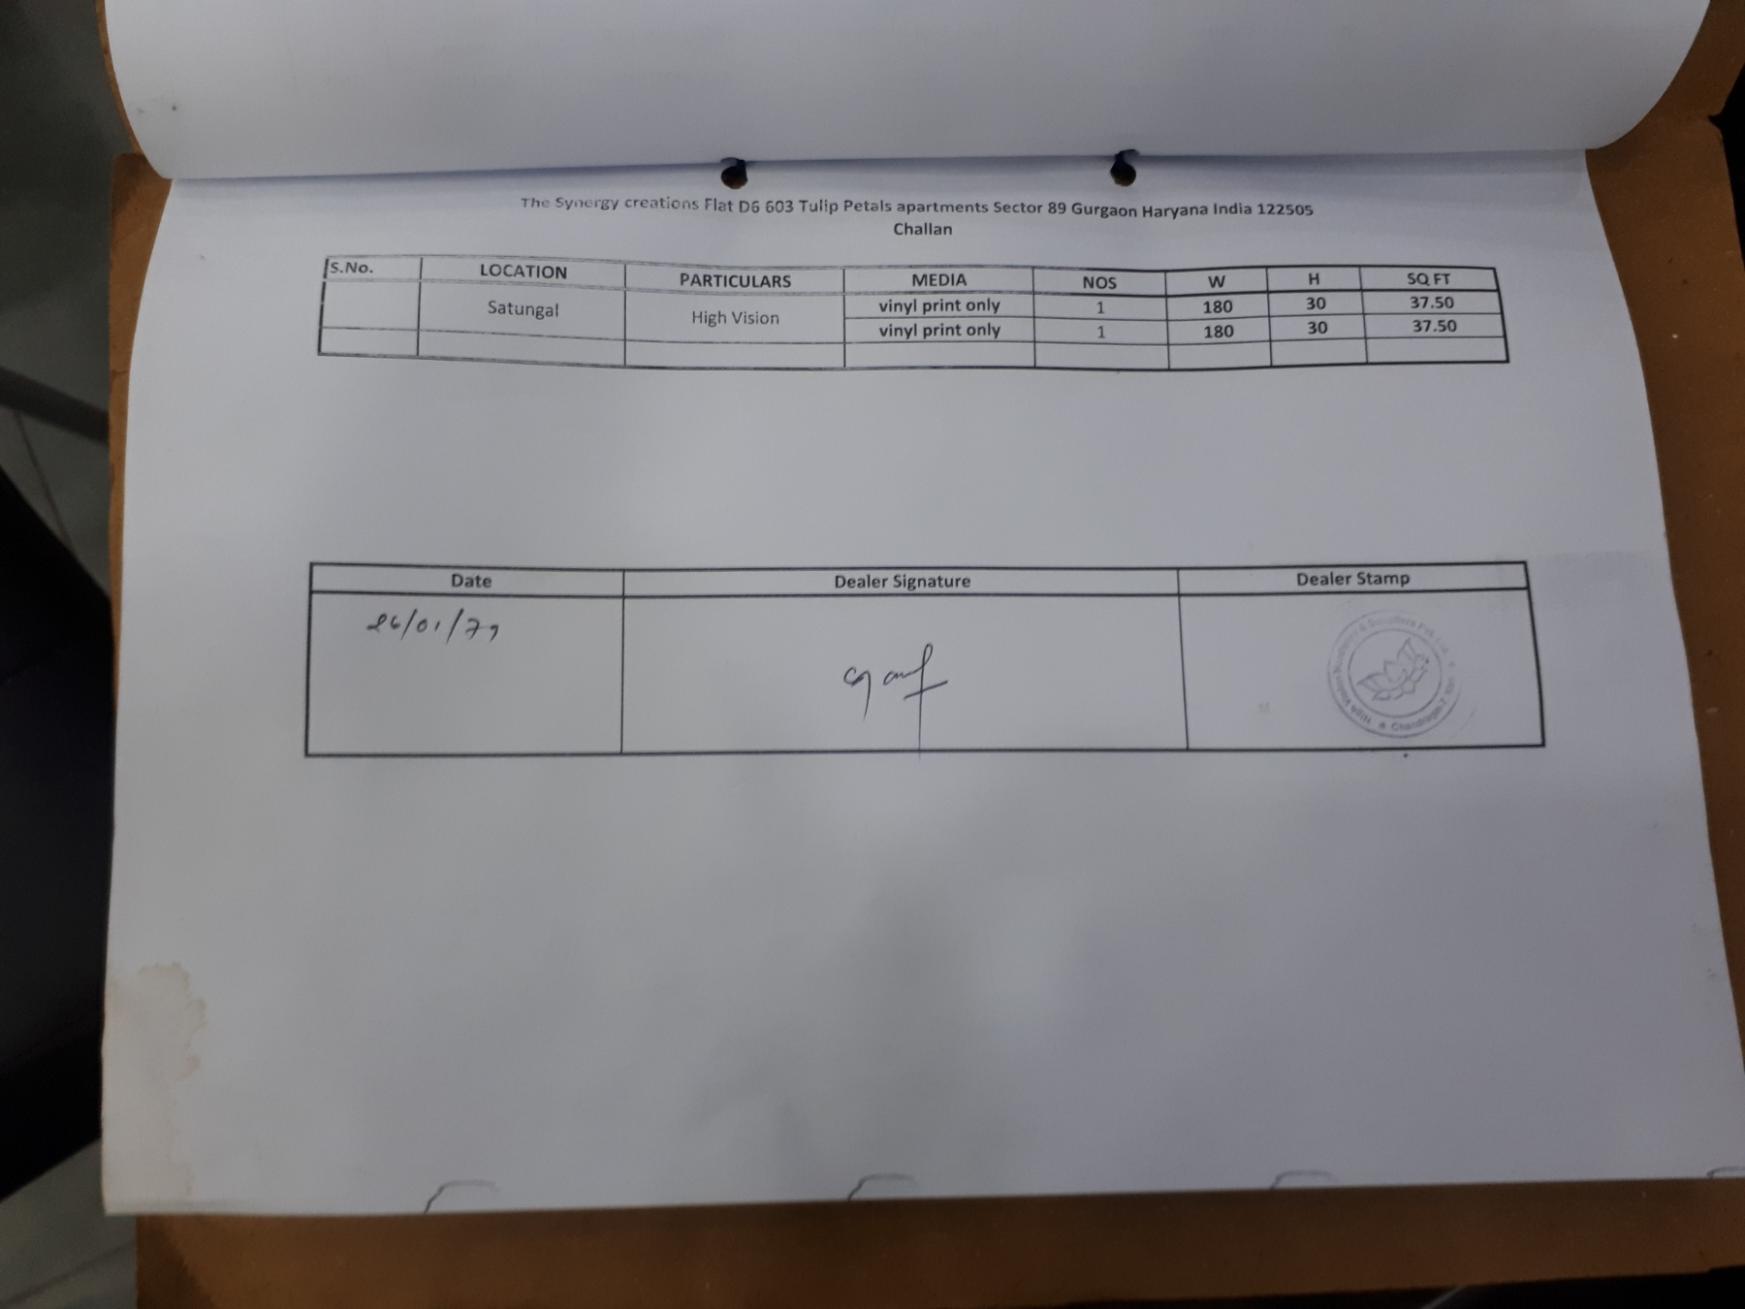

Slide 3
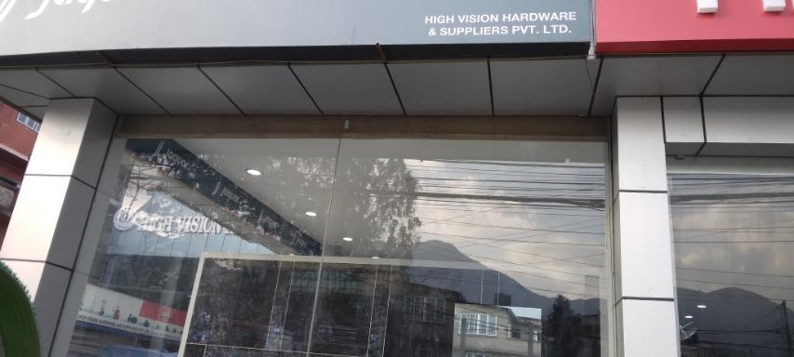
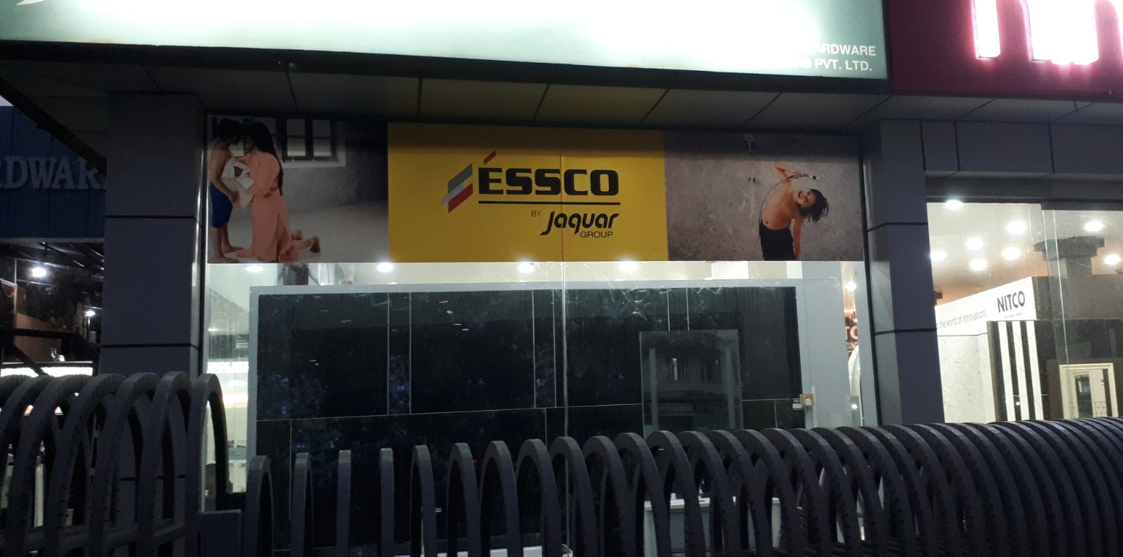
IN STORE
180 inch
30 inch
180X30 inch vinyl print only

Slide 4
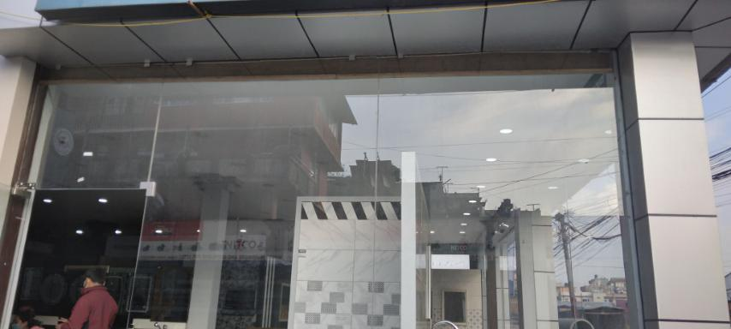
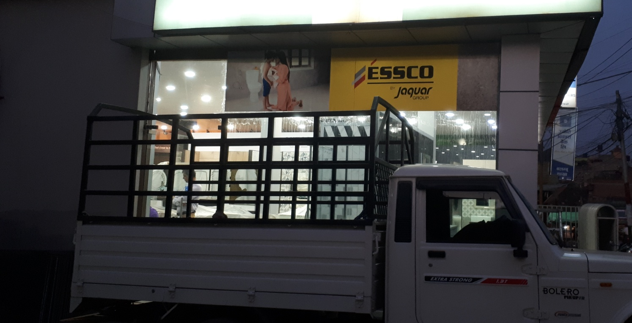
IN STORE
180 inch
30 inch
180x30 inch vinyl print only

