Slide 1
GORAKHKALI COLOR & SANITARY
Harisiddhi

Slide 2
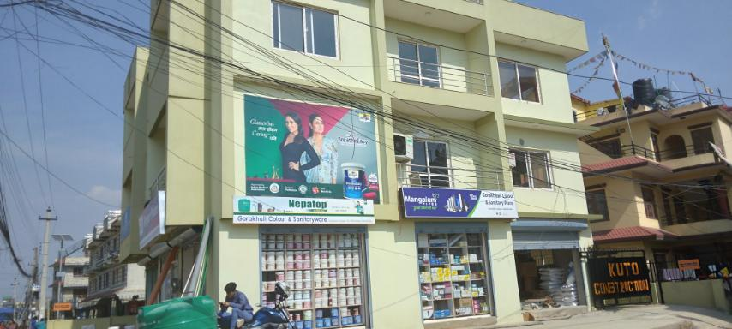
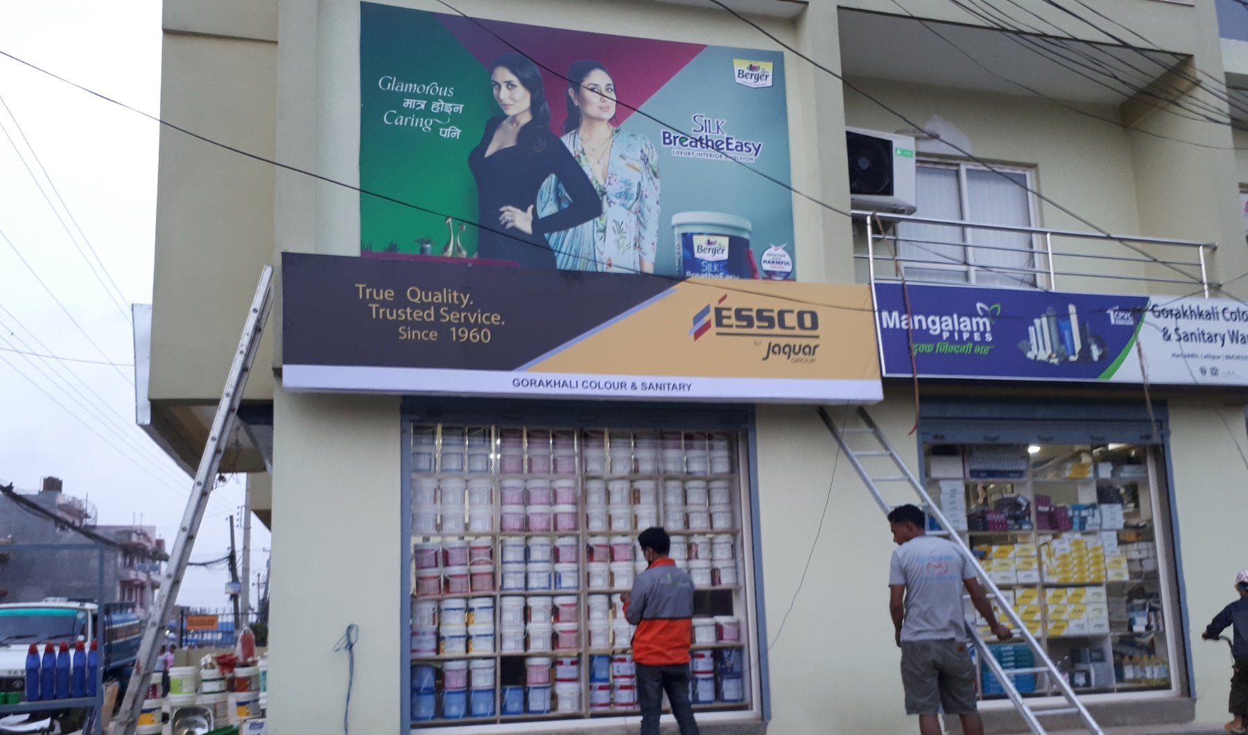
FRONT FAÇADE
Essco
168 inch
36 inch
3x14 ft GSB with angle

Slide 3
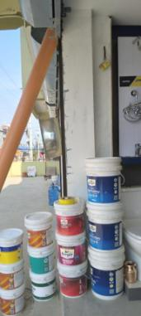
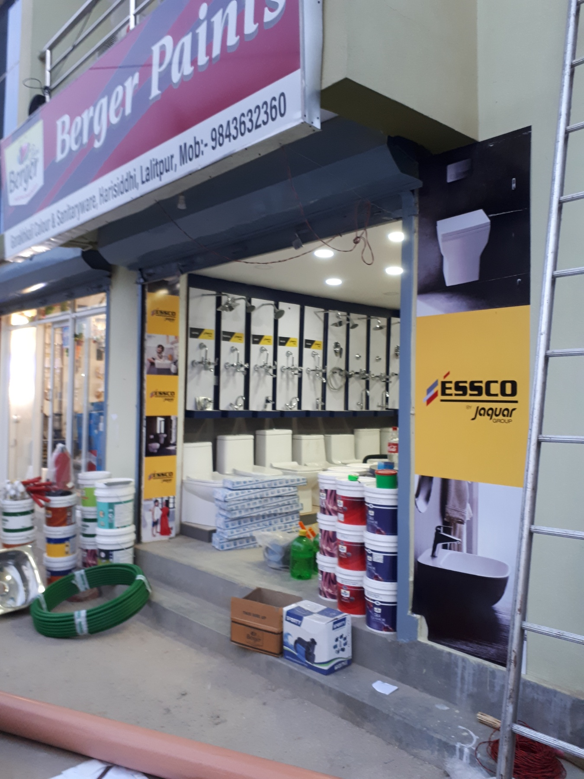
OUTDOOR
96 inch
12 inch
12x96 INCH vinyl with sb

Slide 4
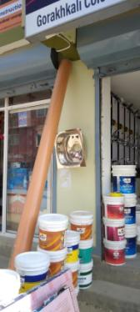
OUTDOOR
96 inch
24 inch
24x96 INCH vinyl with sb

