Slide 1
EKATA HARDWARE
Balkot

Slide 2
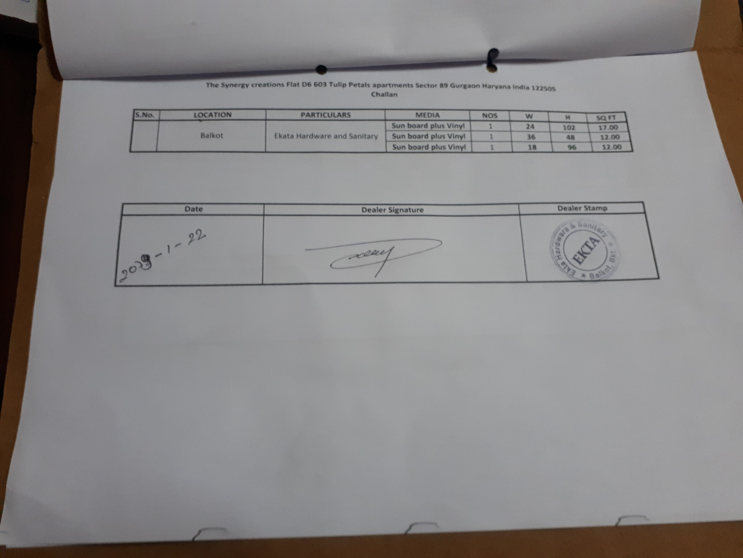

Slide 3
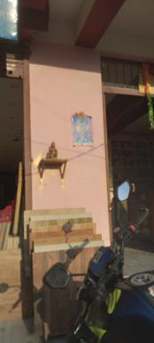
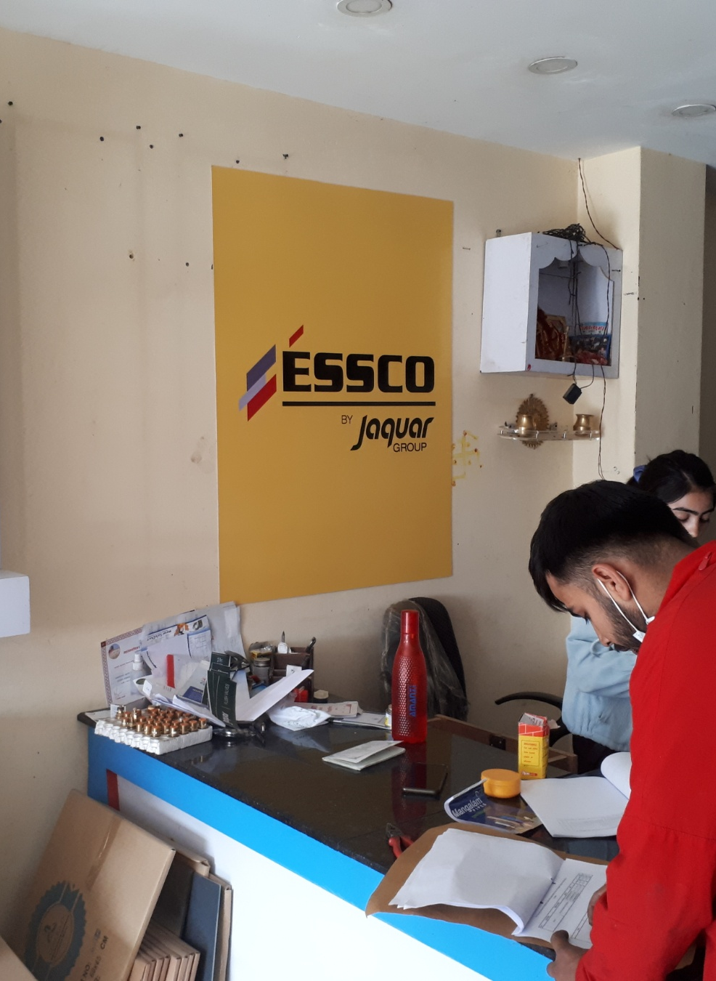
IN SIDE
36 inch
48 inch
Essco logo
36X48 inch vinyl with sb

Slide 4
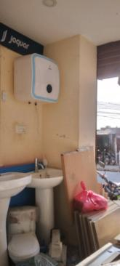
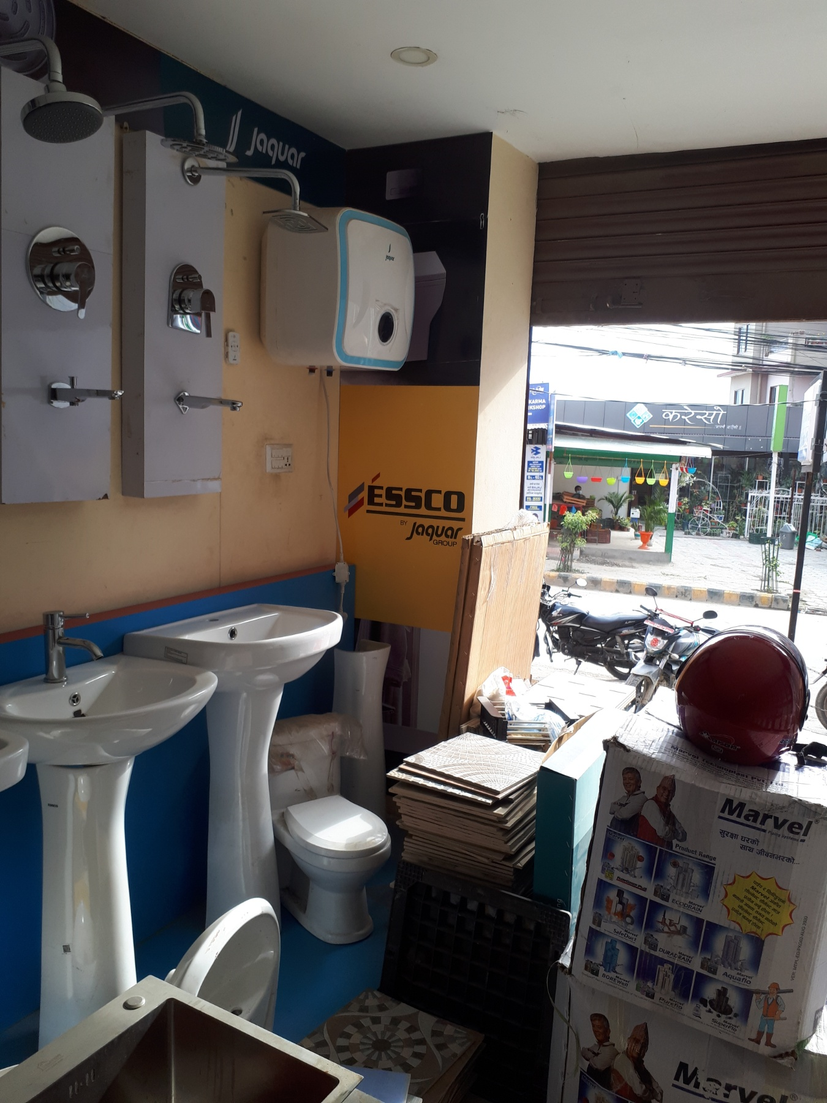
IN STORE
24 inch
Essco
102 inch
24X102 inch vinyl with sb

Slide 5

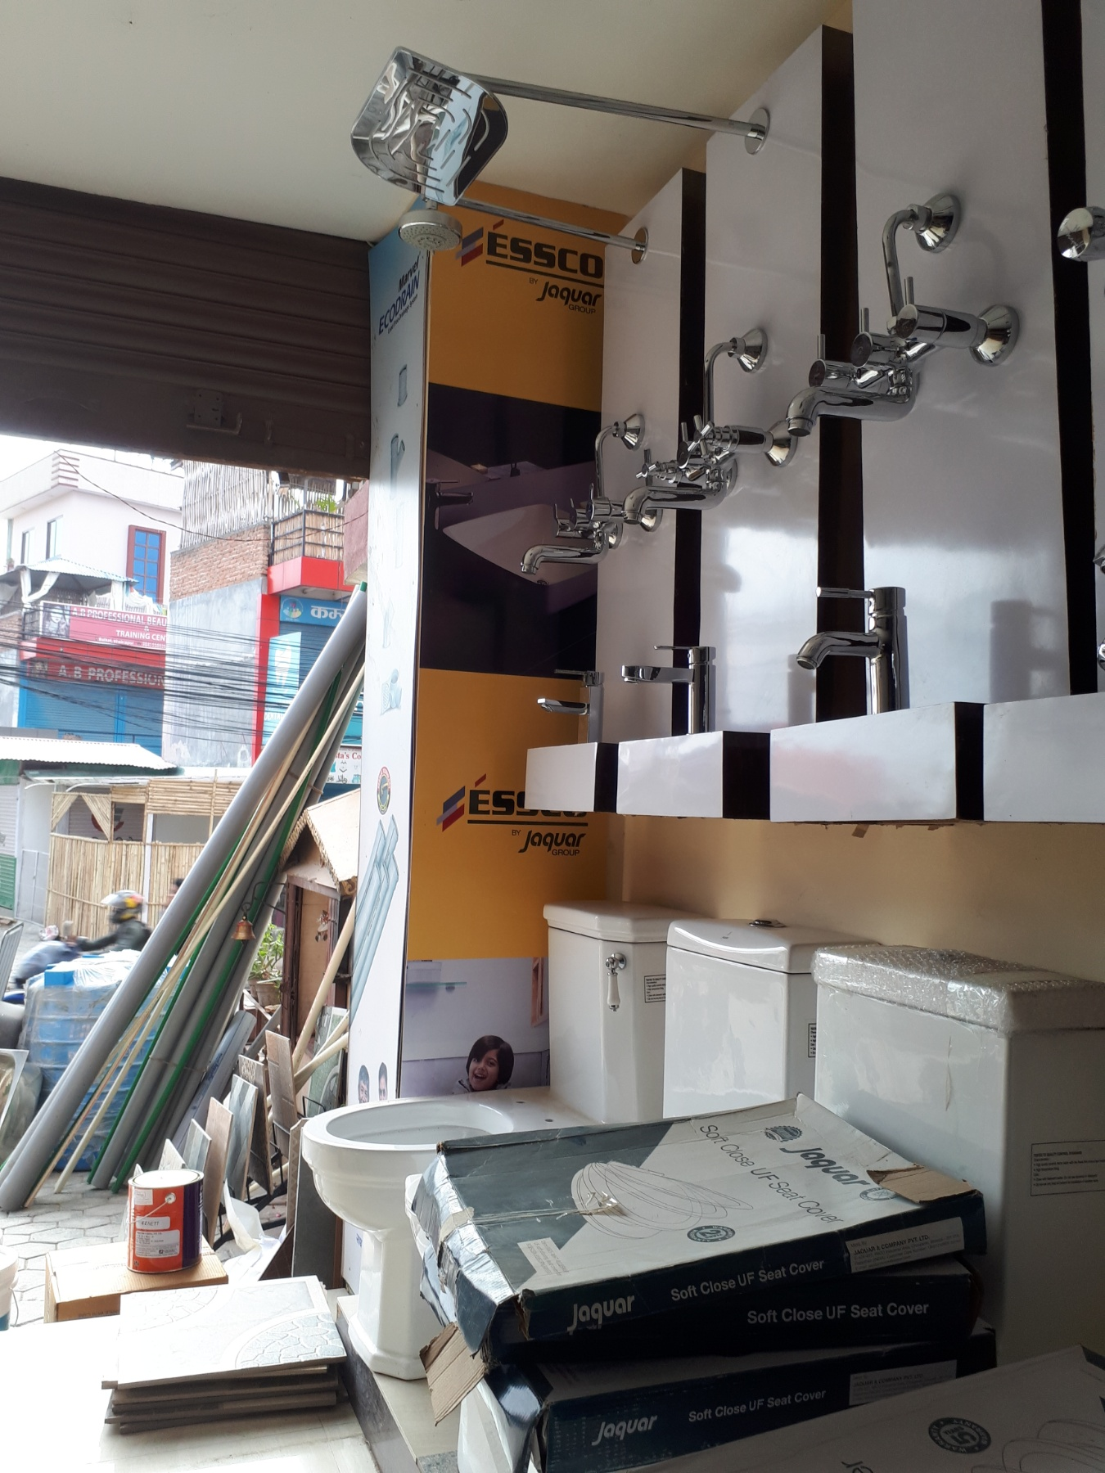
IN STORE
18 inch
Essco
96 inch
18X96 inch vinyl with sb

