Slide 1
Chhaya Hardware
Imadol

Slide 2
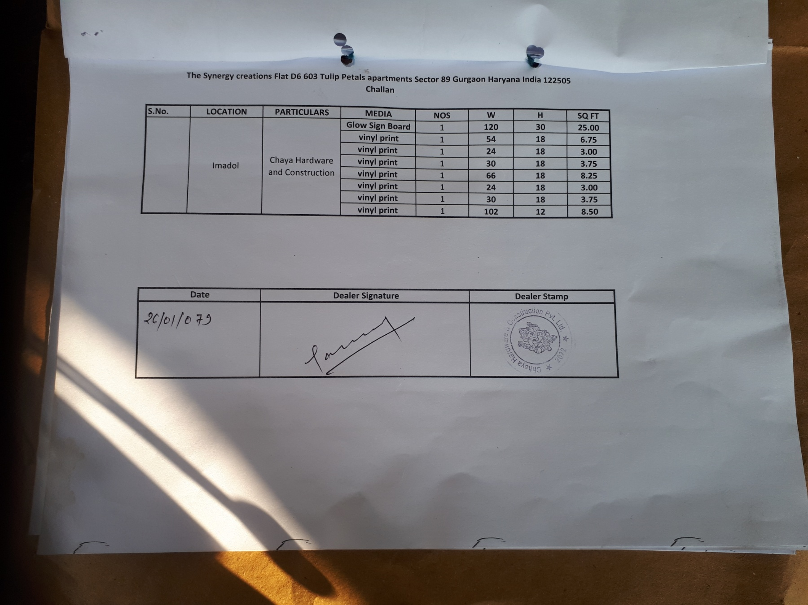

Slide 3
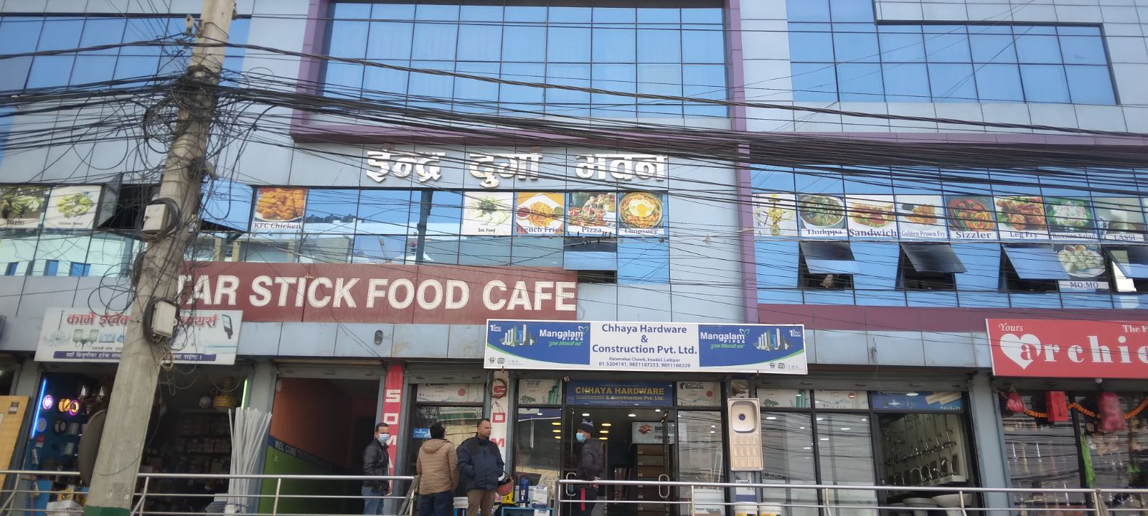
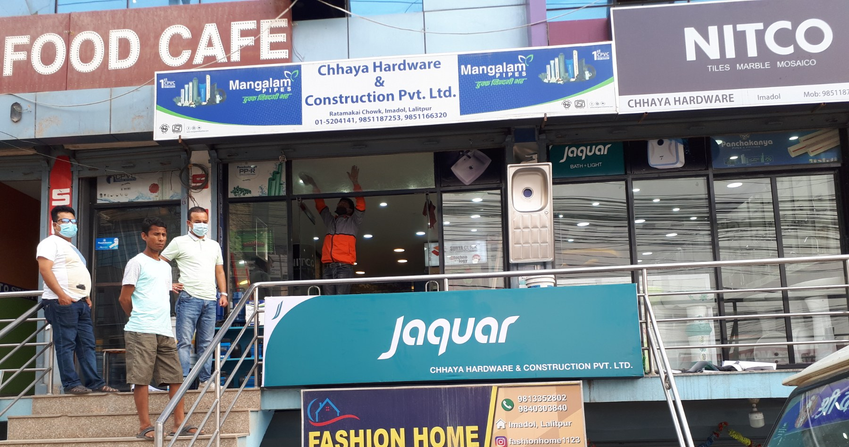
FRONT FAÇADE
120 inch
30 inch
2.5x10 ft GSB with angle

Slide 4
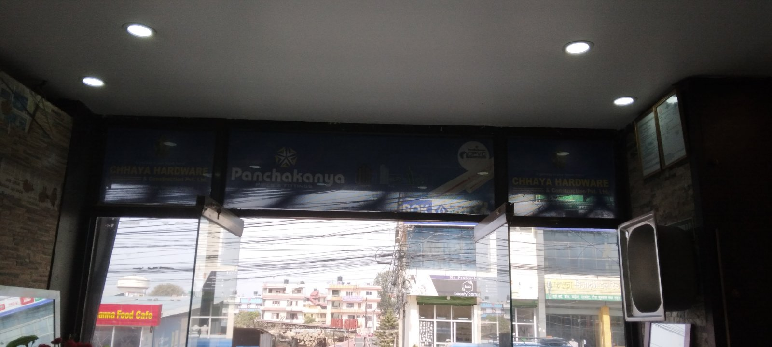
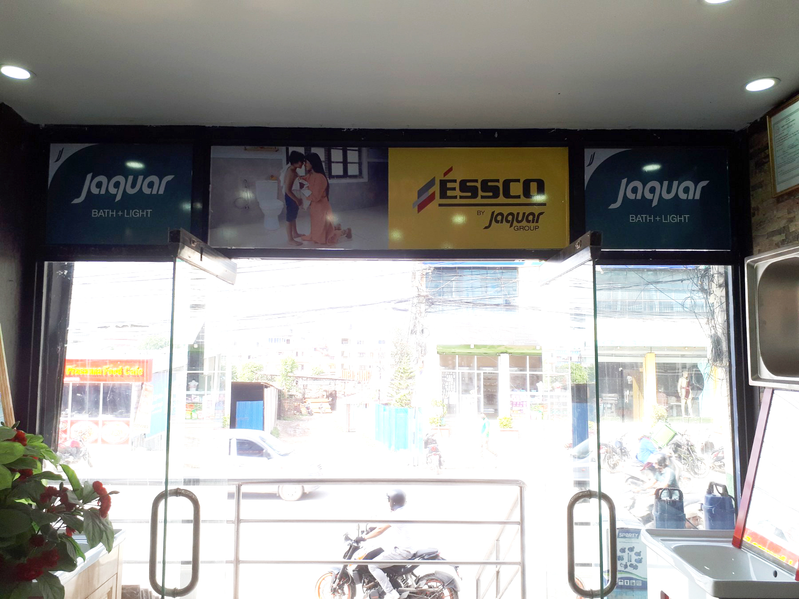

IN STORE
30 inch
Jaquar logo
18 inch
18x30 inch Vinyl print only

Slide 5
IN STORE
54 inch
18 inch
18x54 inch Vinyl print only

Slide 6
IN STORE
24 inch
18 inch
18x24 inch Vinyl print only

Slide 7
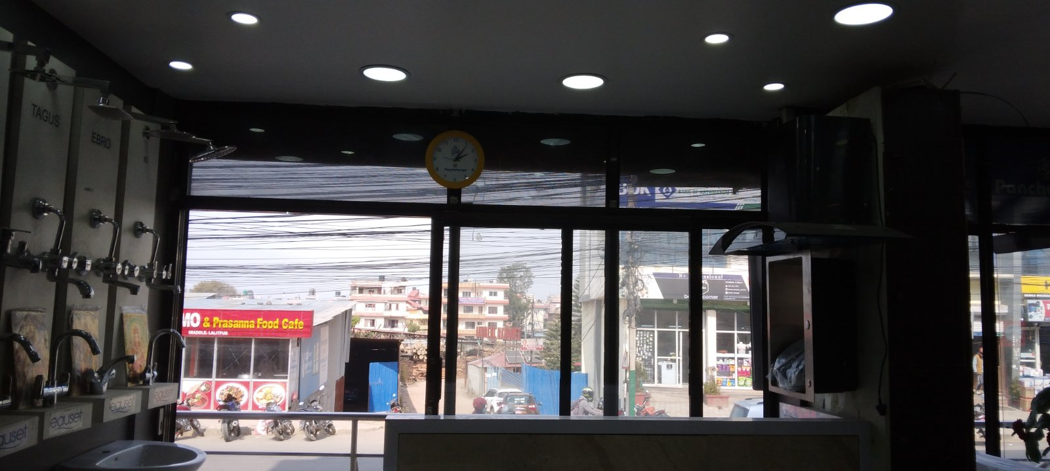
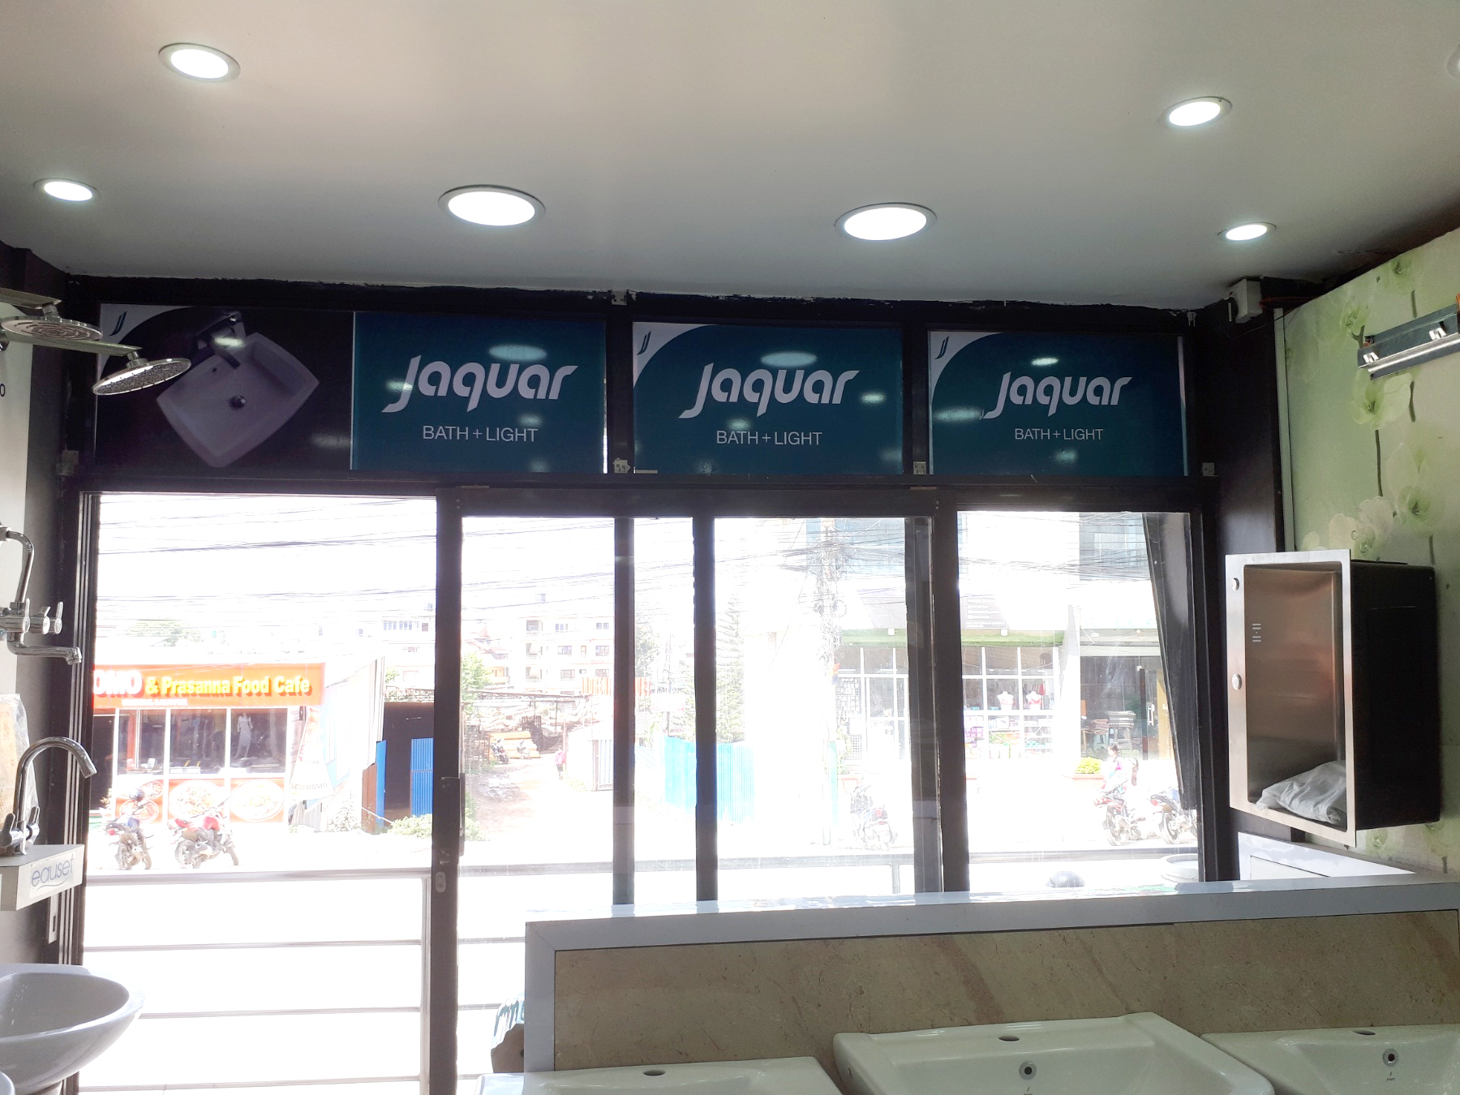
IN STORE
66 inch
18 inch
18x66 inch Vinyl print only

Slide 8

IN STORE
24 inch
18 inch
Jaquar
18x24 inch Vinyl print only

Slide 9
IN STORE
30 inch
Jaquar
18 inch
18x30 inch Vinyl print only

Slide 10
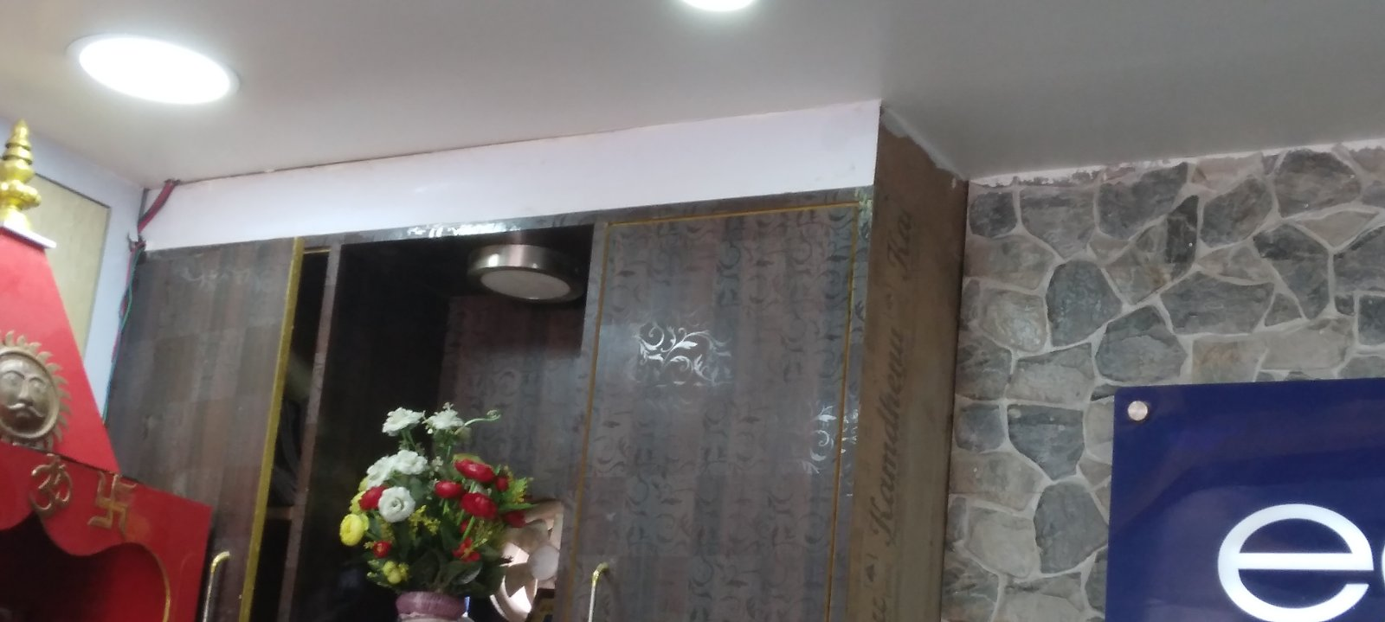
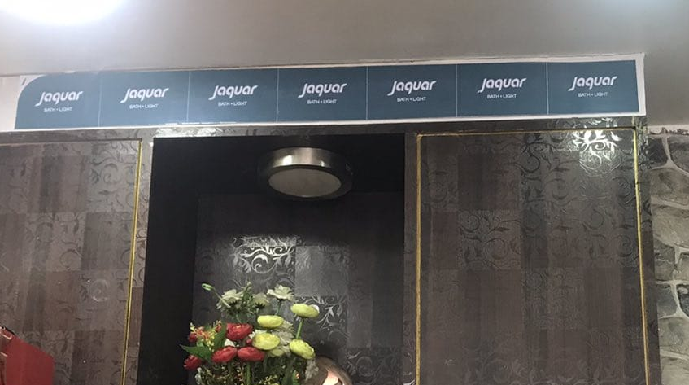
IN STORE
102 inch
12 inch
Logo
12x102 inch Vinyl print only

