Slide 1
PATHKIND _Signage_Project
55, 56, Sector-18, Udyog Vihar, Gurgaon

Slide 2
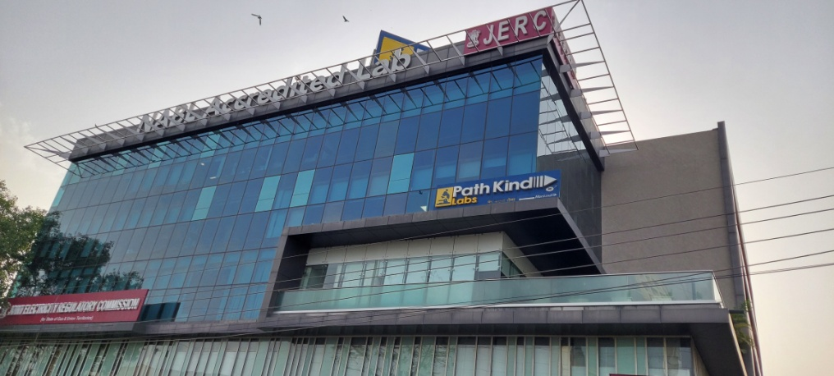
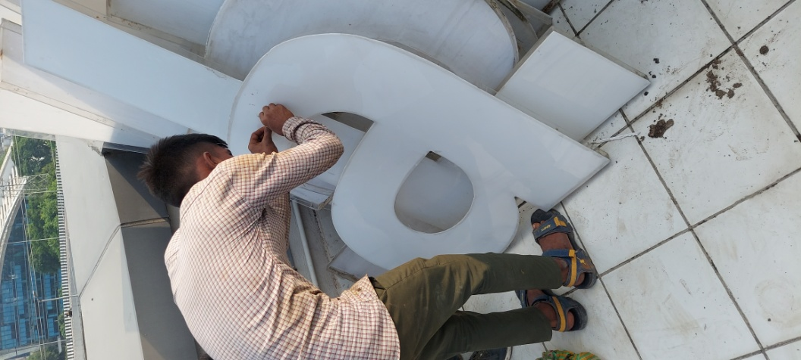
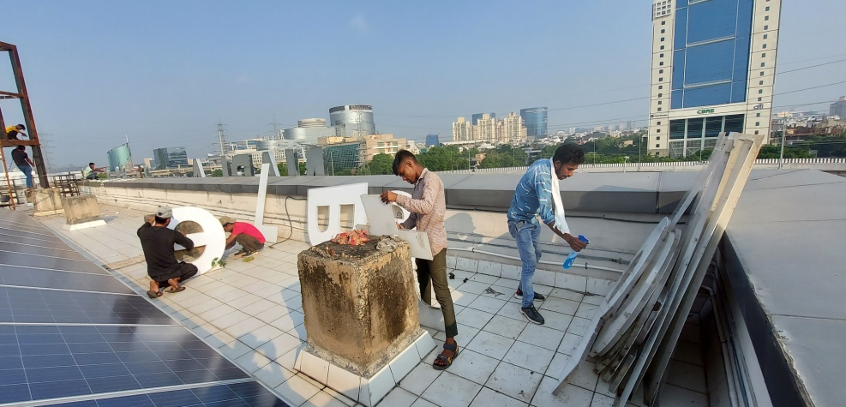
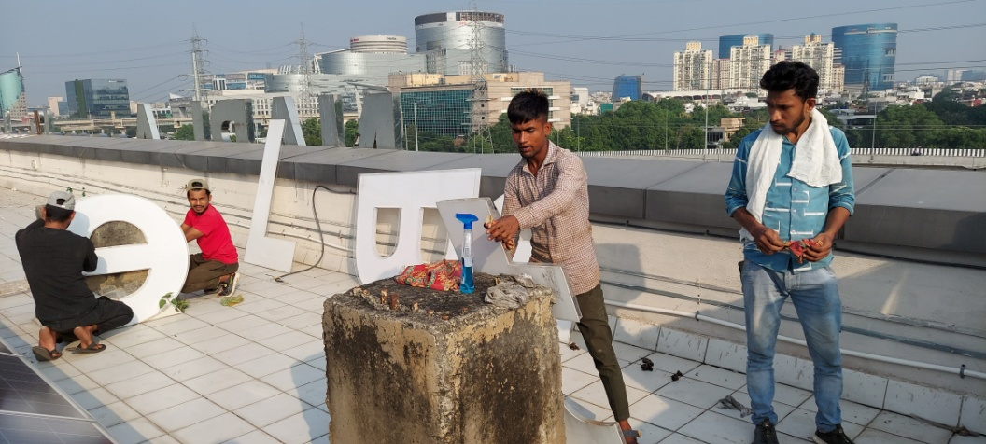
NABL Letter Cleaning Recification_Change All Modules & SMPS

Slide 3
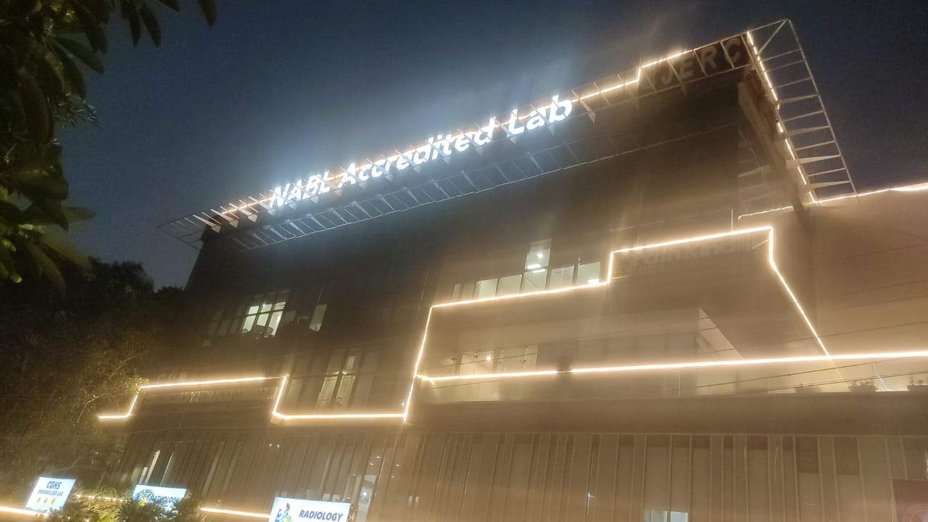
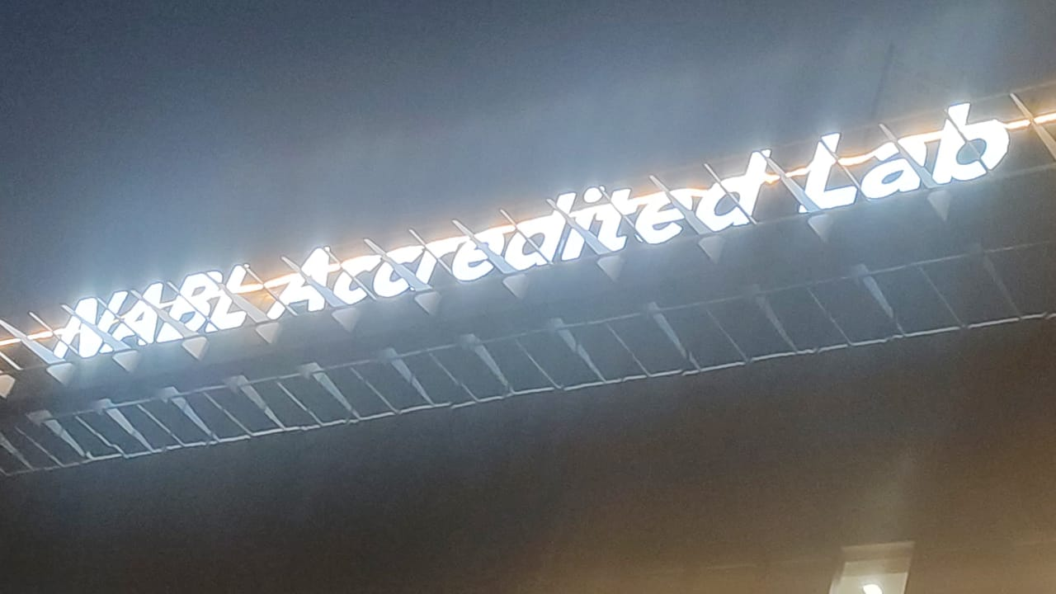
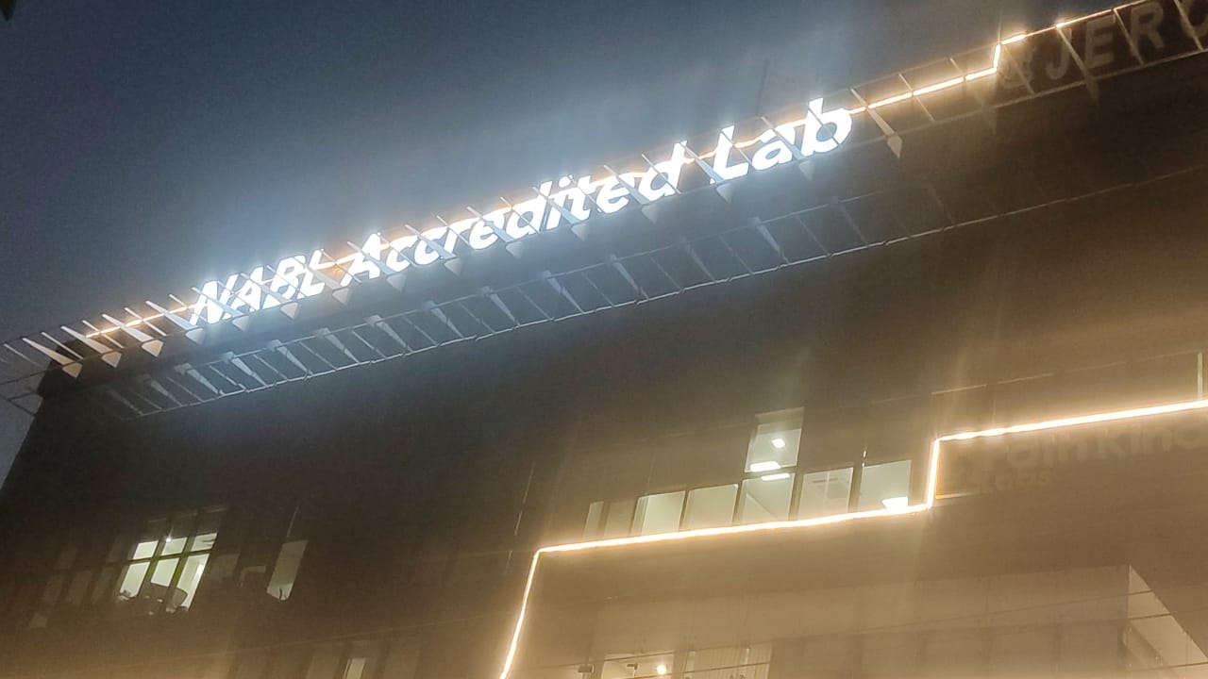
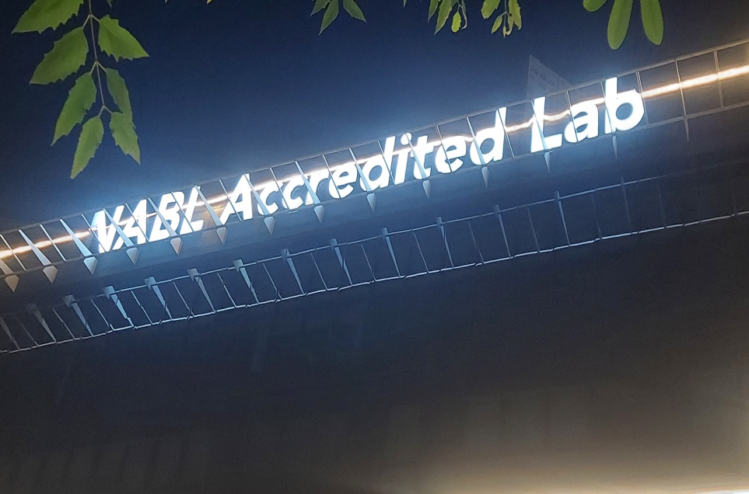
NABL Letter Recification_Change All Modules & SMPS

Slide 4
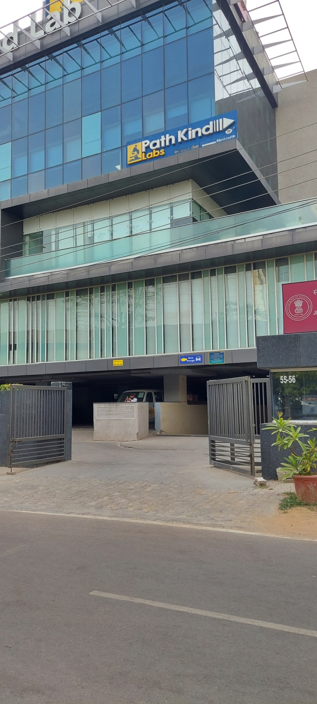
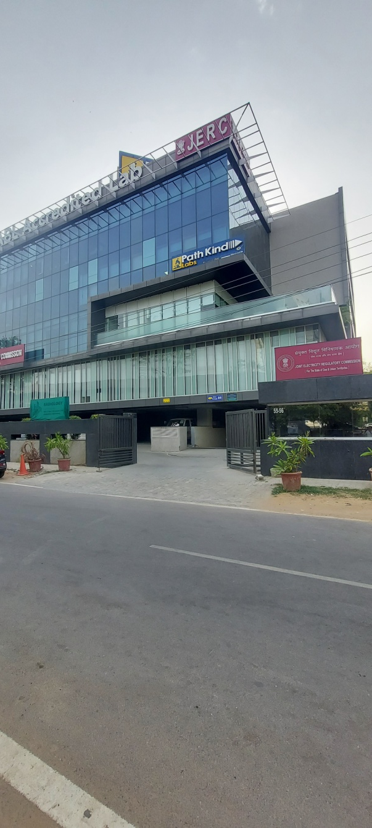
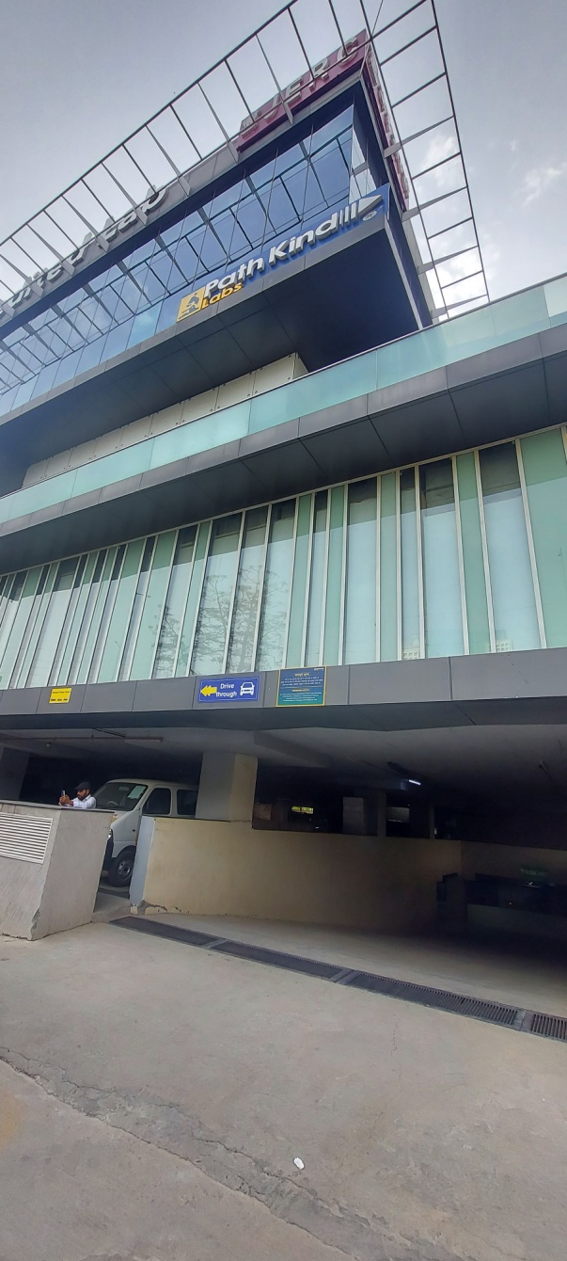
Pathkind Signage 25 x 5 Feet_Before Image

Slide 5
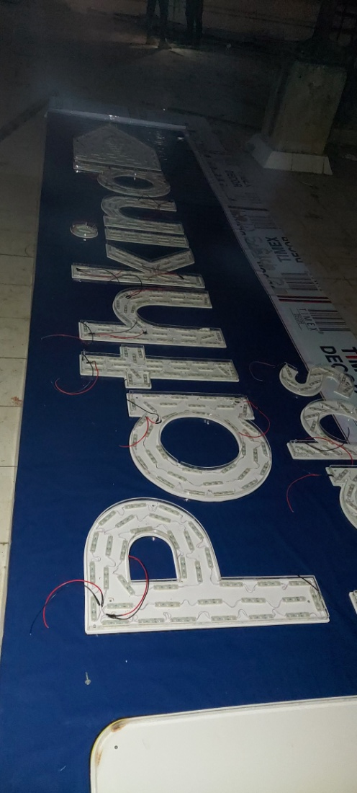
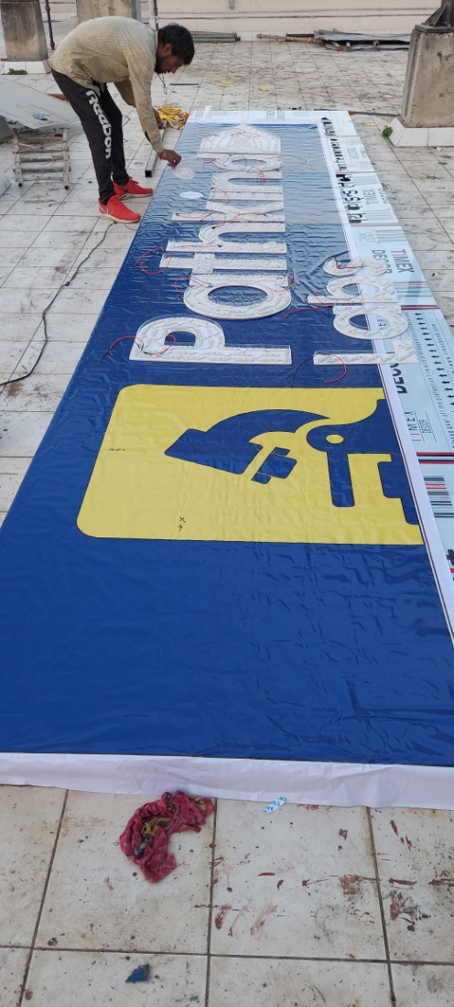
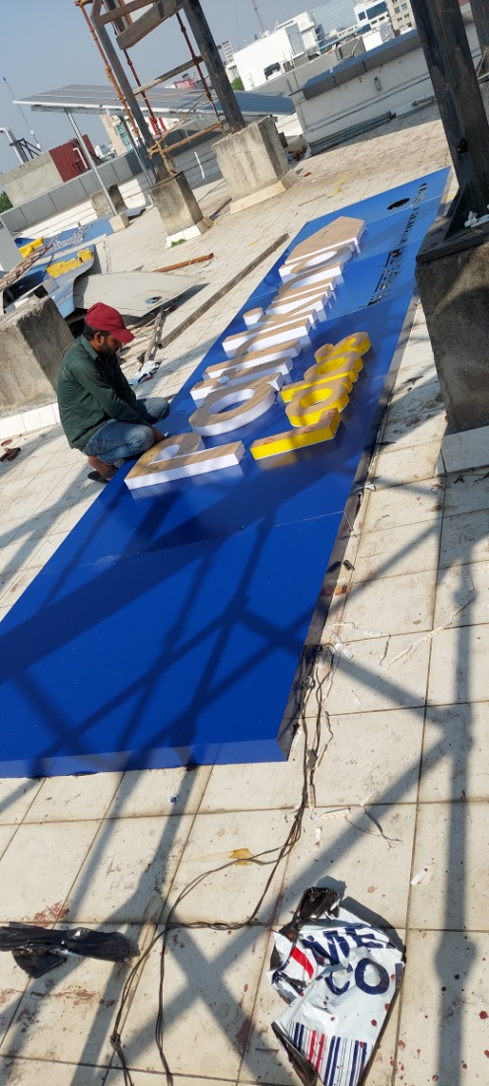
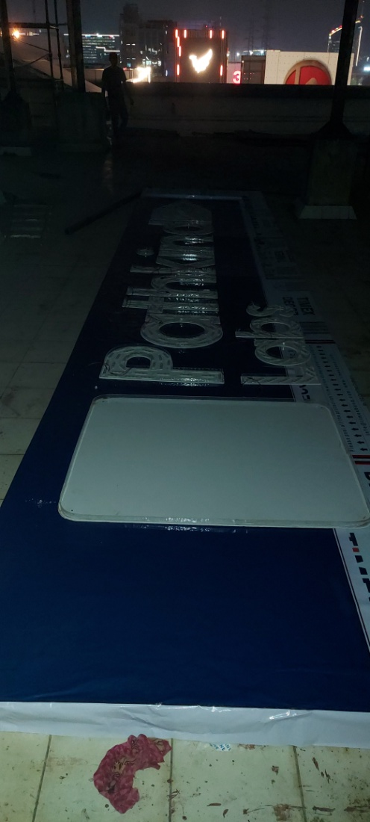
Pathkind Signage 25 x 5 Feet_Production Image

Slide 6
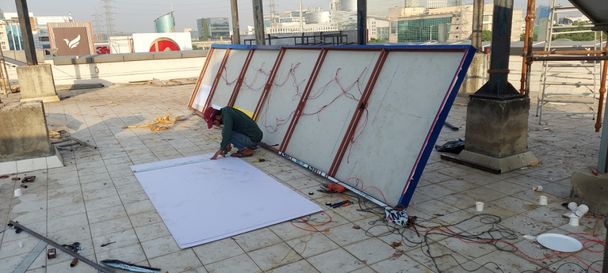
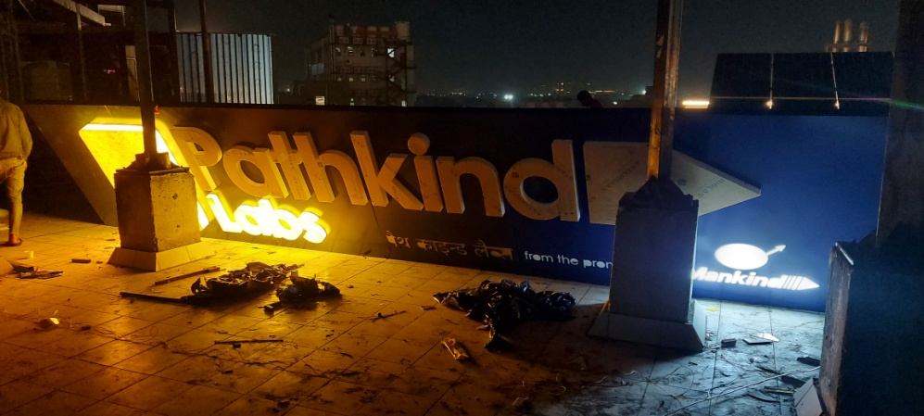
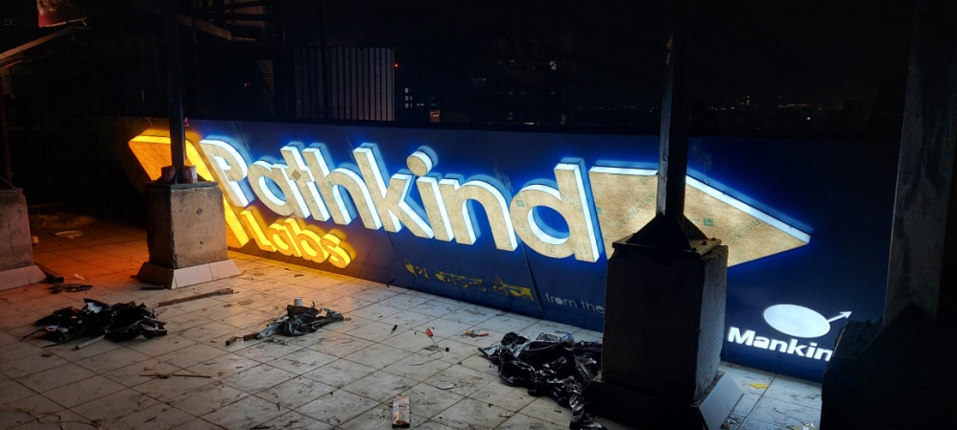
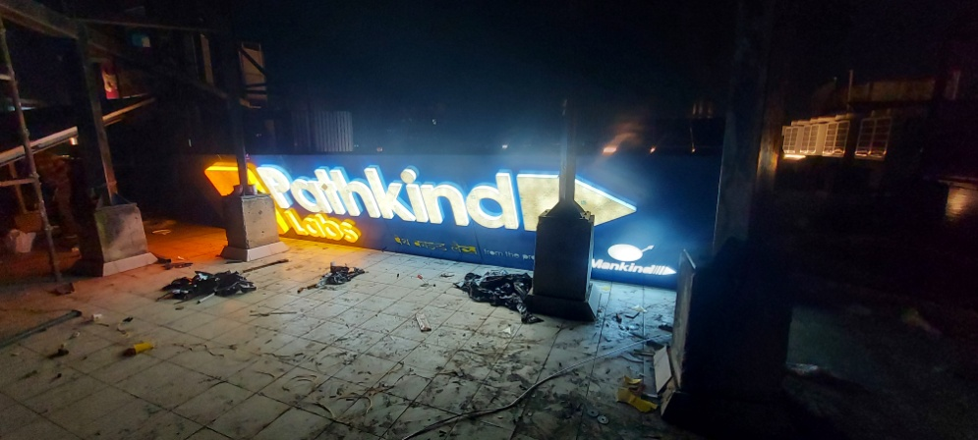
Pathkind Signage 25 x 5 Installed
Pathkind Signage 25 x 5 Feet_Production Image

Slide 7
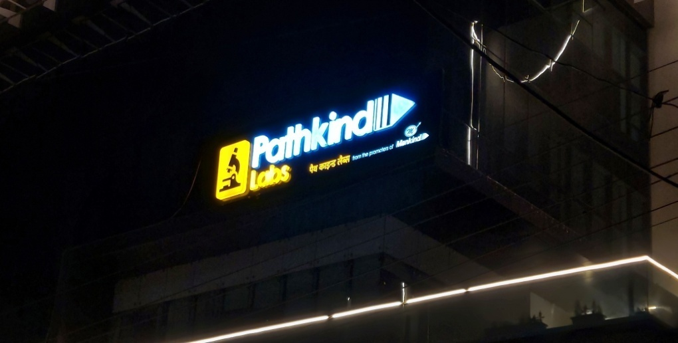
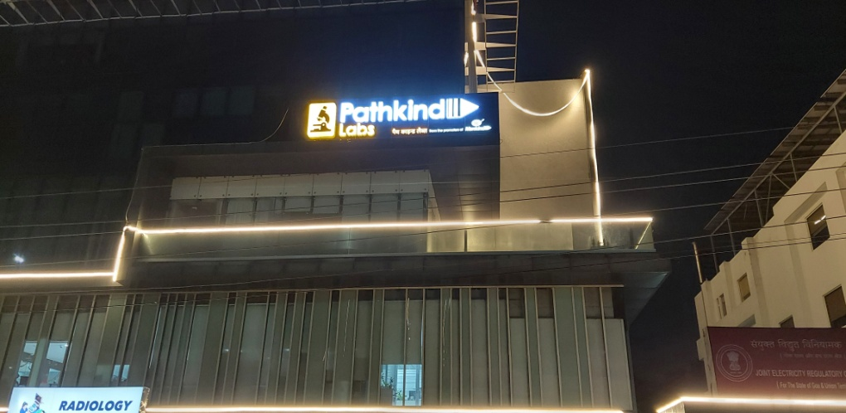
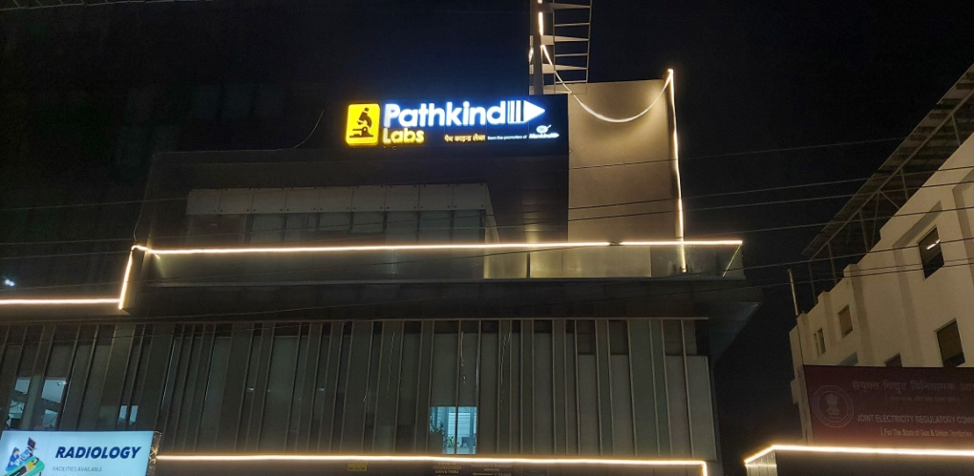
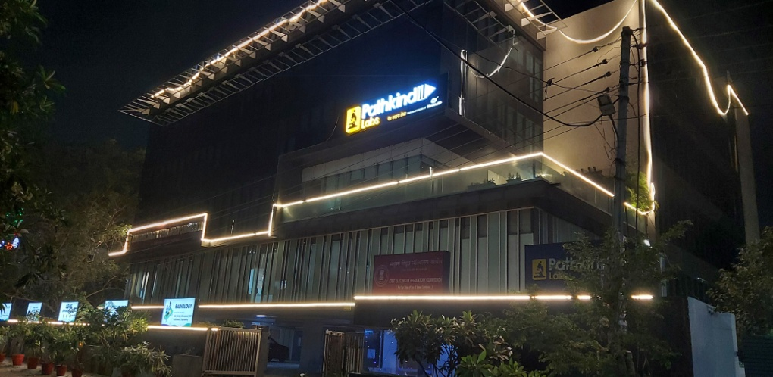
Pathkind Signage 25 x 5 Installed
Pathkind Signage 25 x 5 Feet_Installed Image

Slide 8
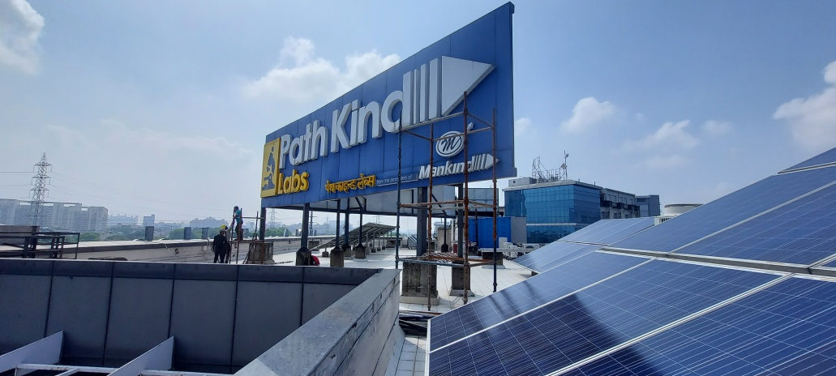
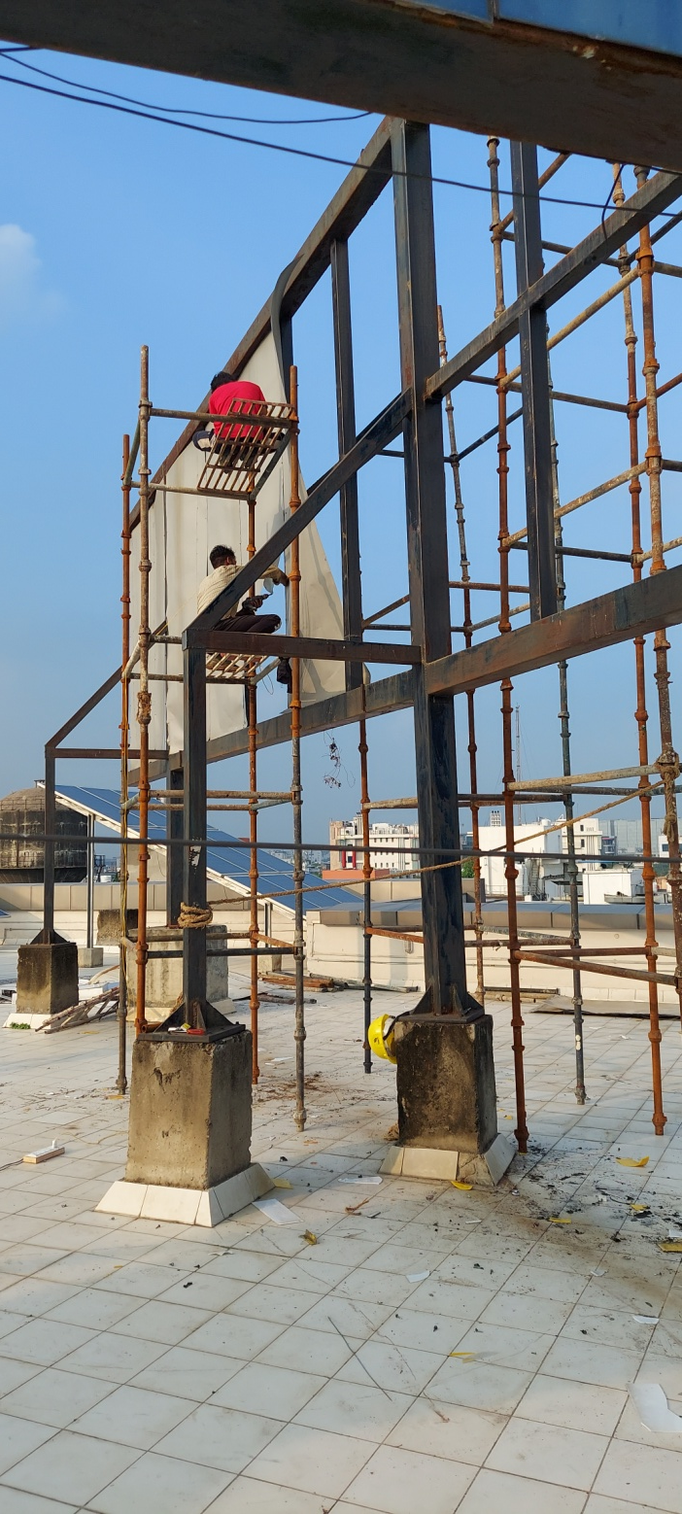
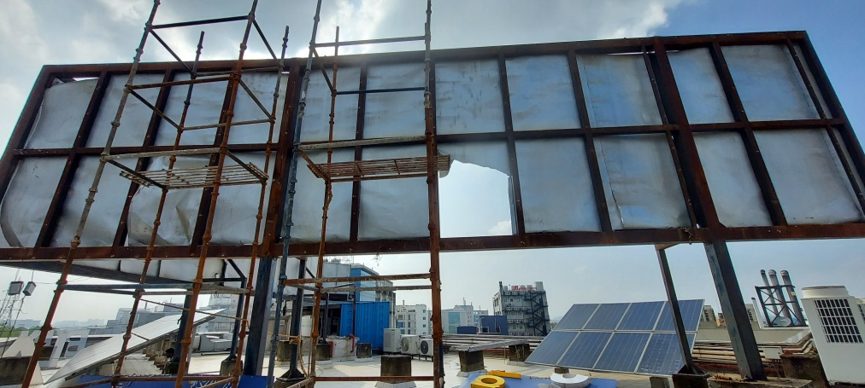
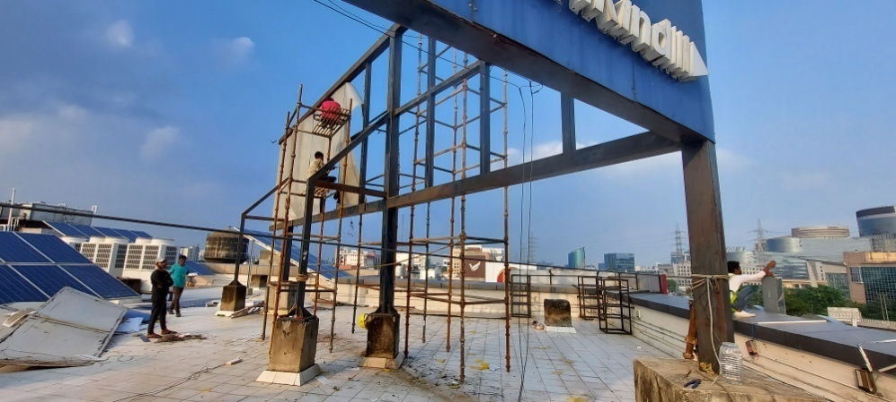
Main Signage Pre-Installed & Remove Signage Images
Notes:
Main Signage Pre-Installed Images

Slide 9
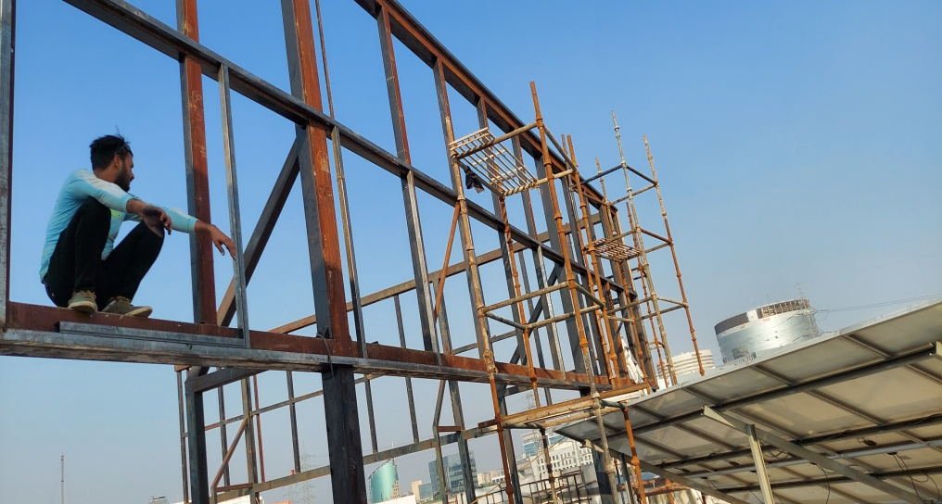
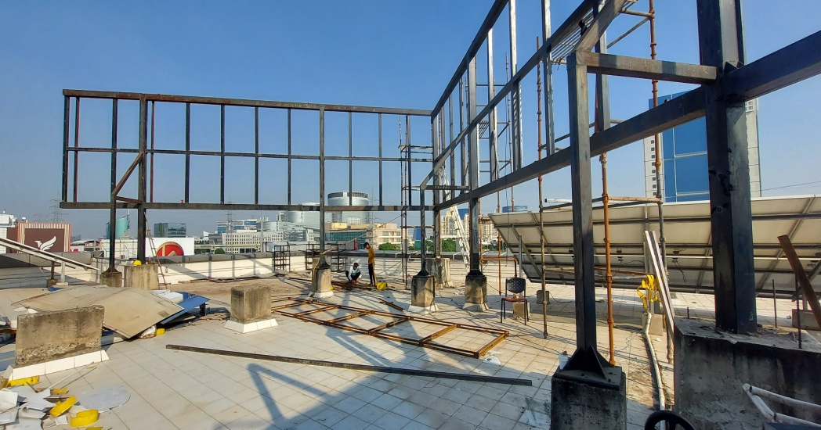
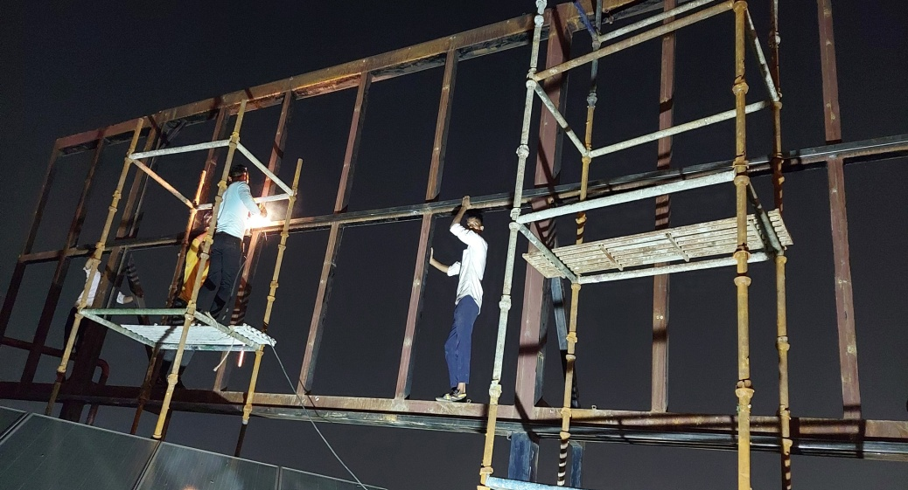
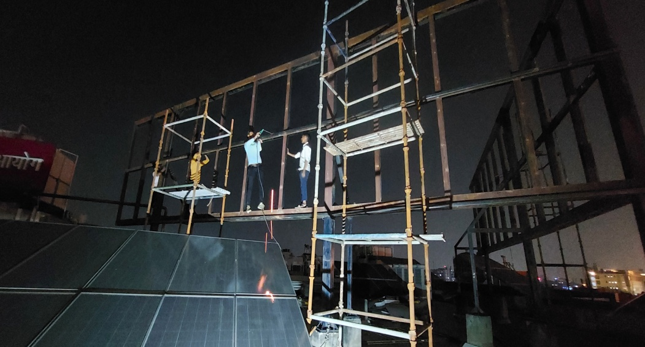
Main Signage MS Framing

Slide 10
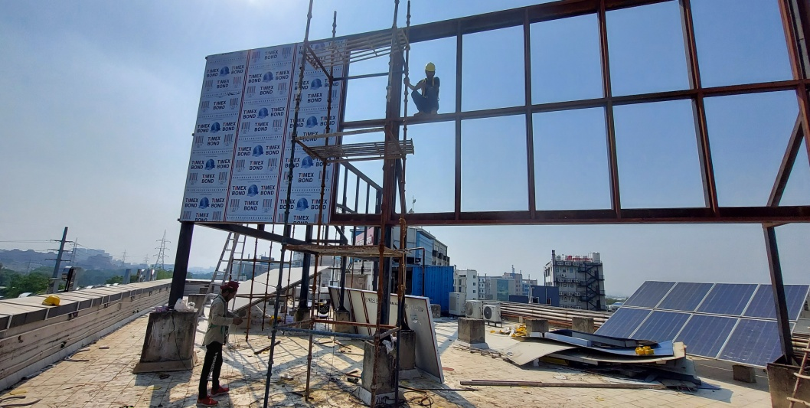
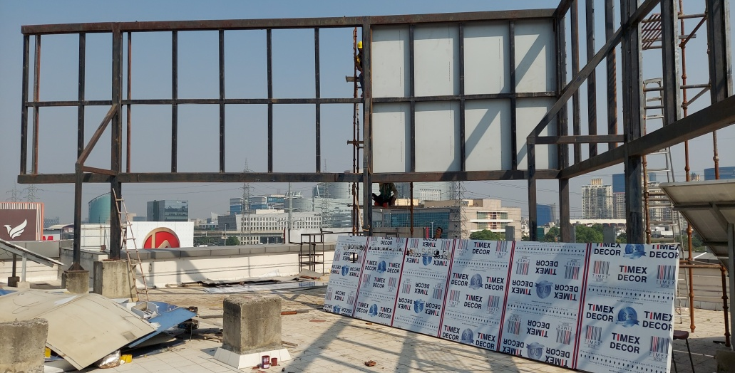
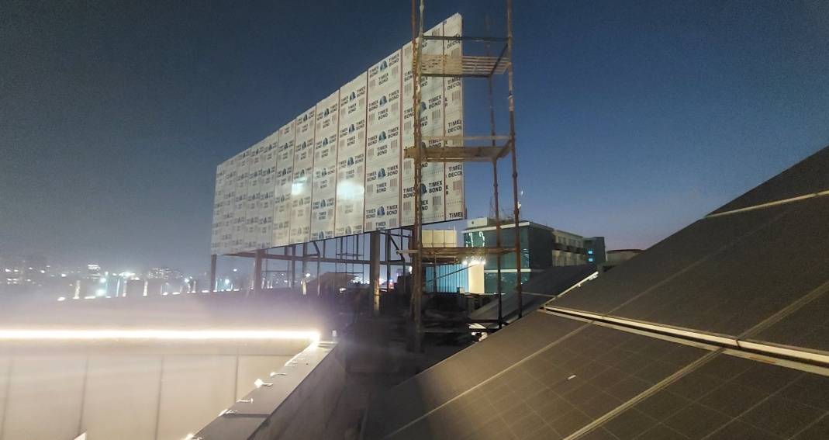
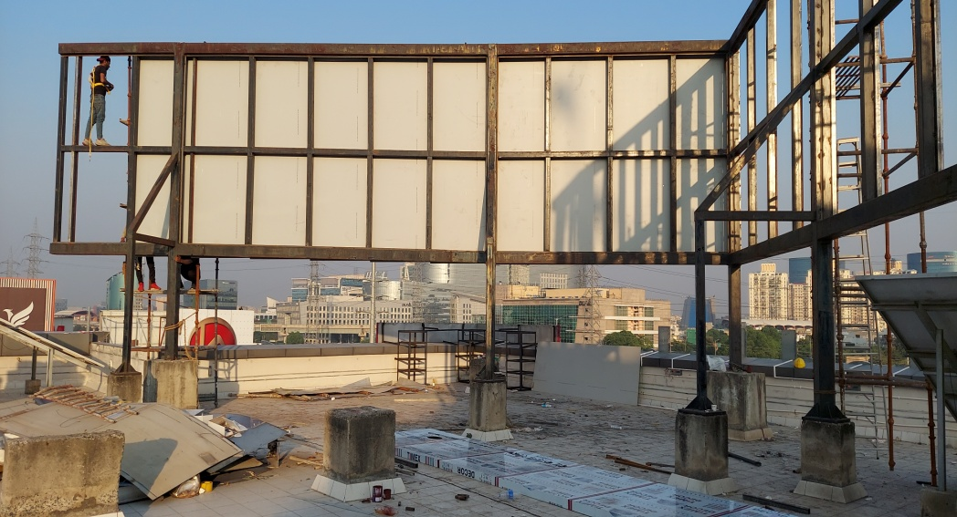
Main Signage 4mm ACP Cladding on MS Frame

Slide 11
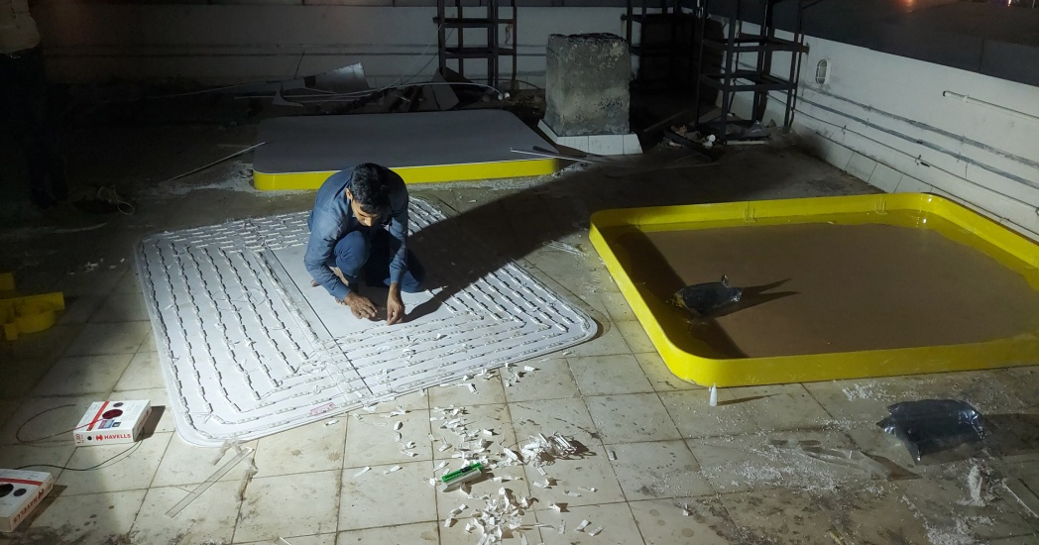
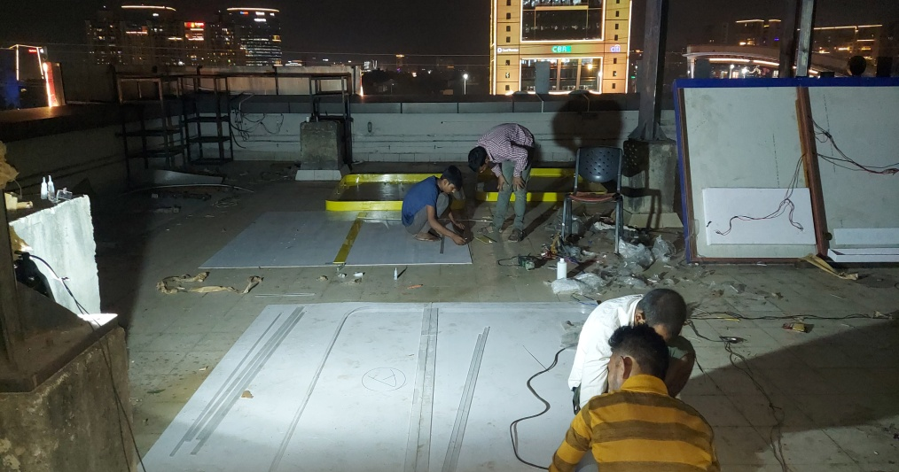
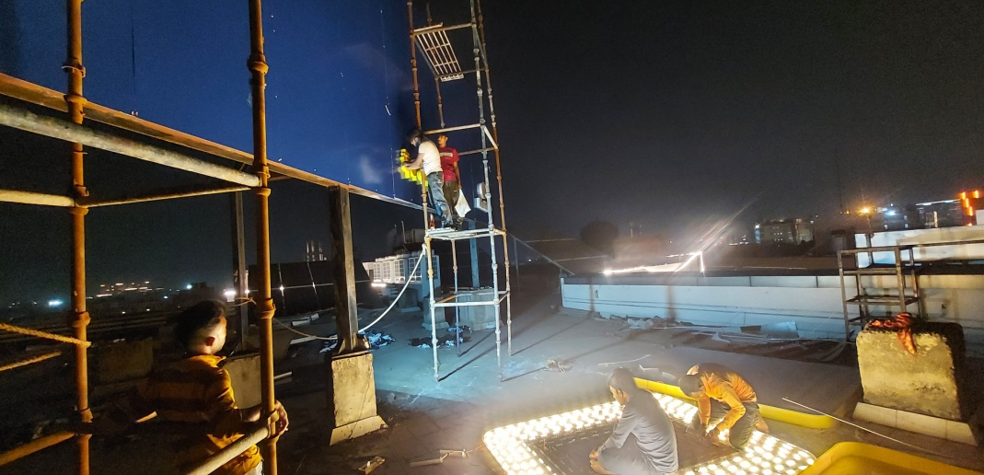
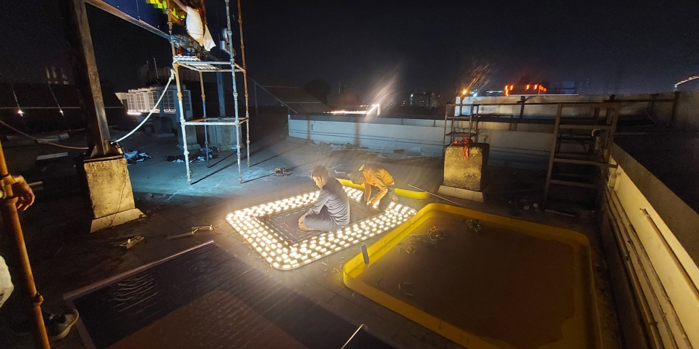
Main Signage Logo image

Slide 12
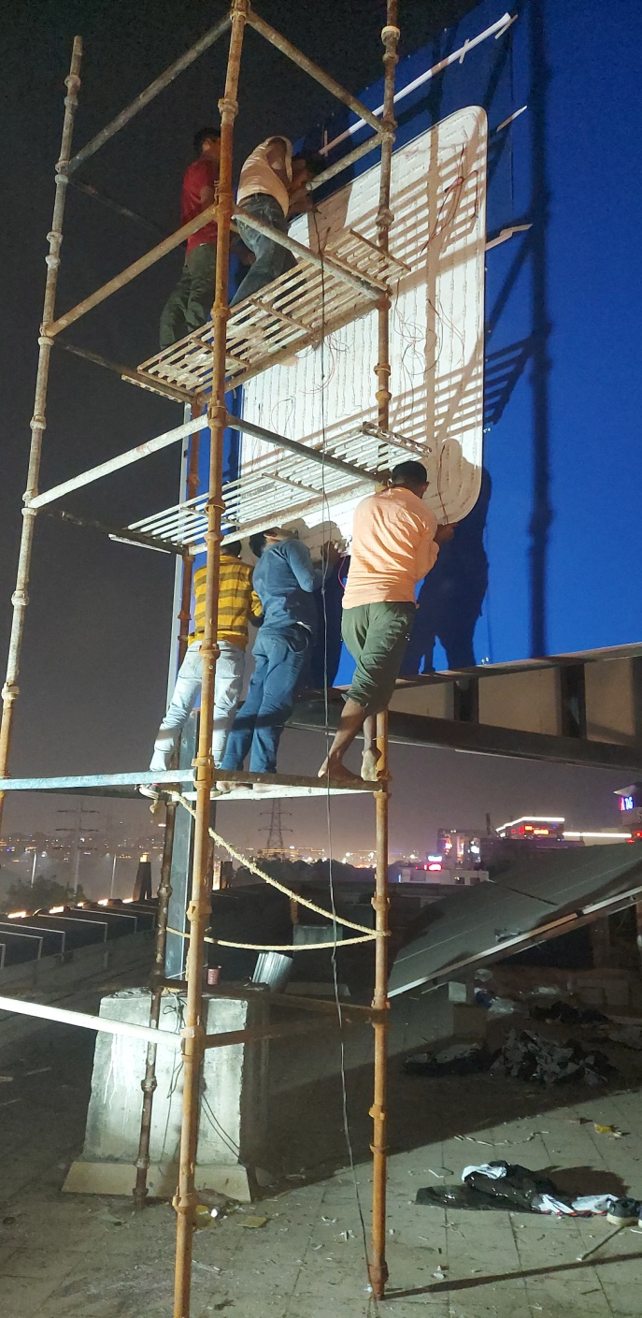
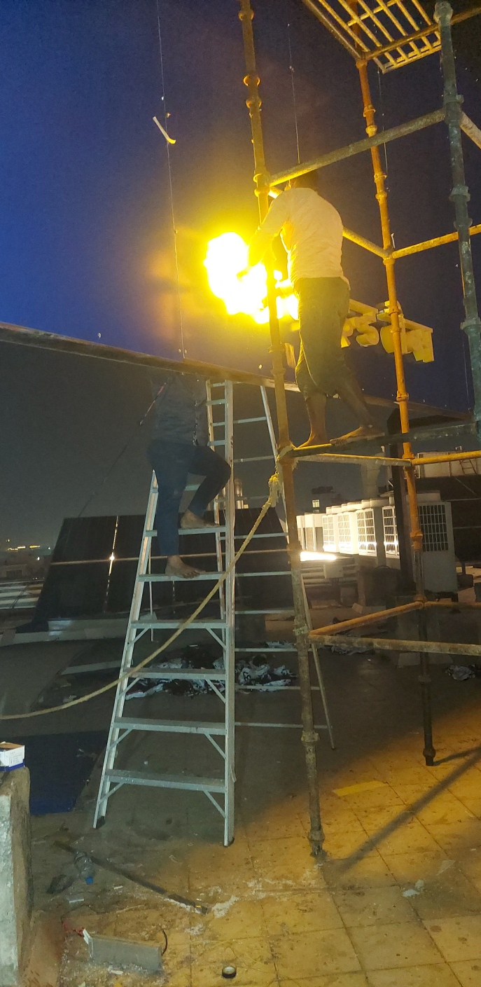
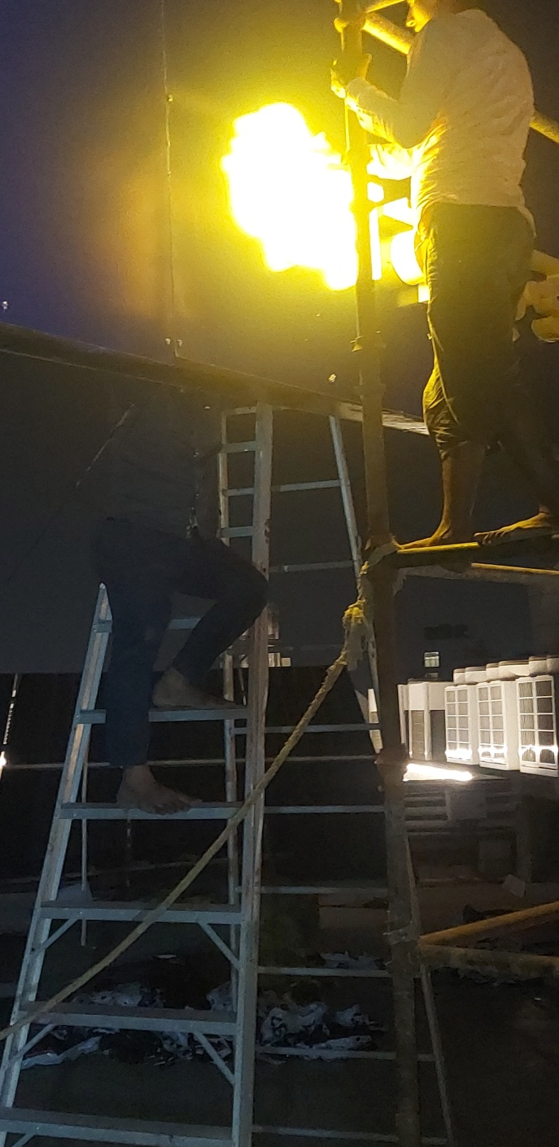
Main Signage Logo & Letter Installation image

Slide 13
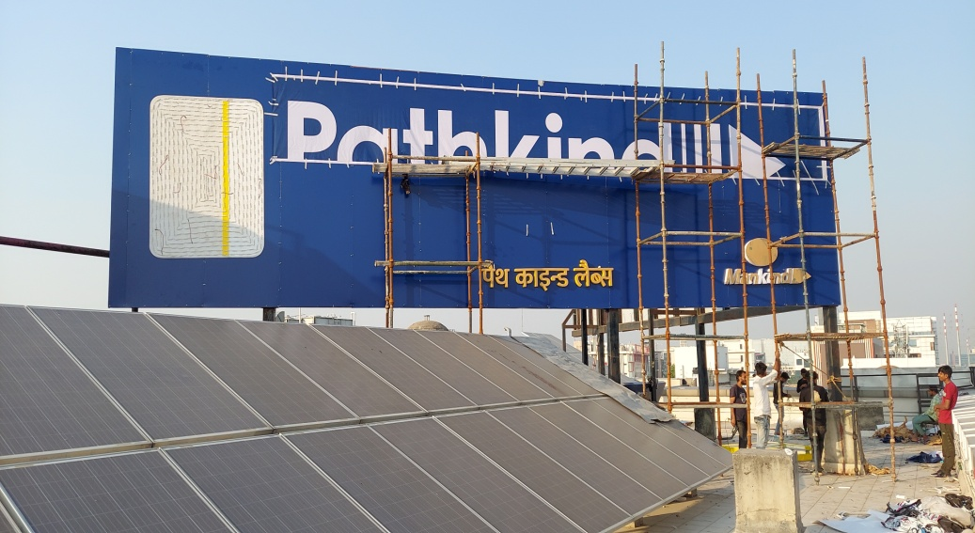
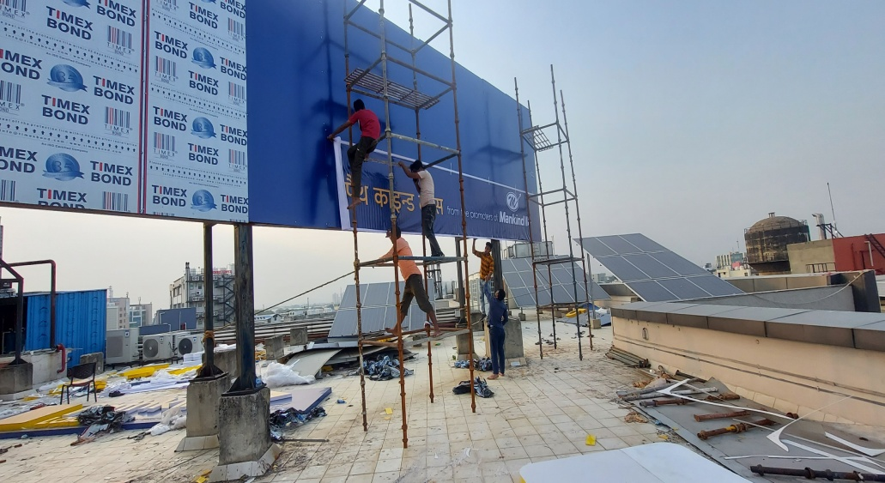
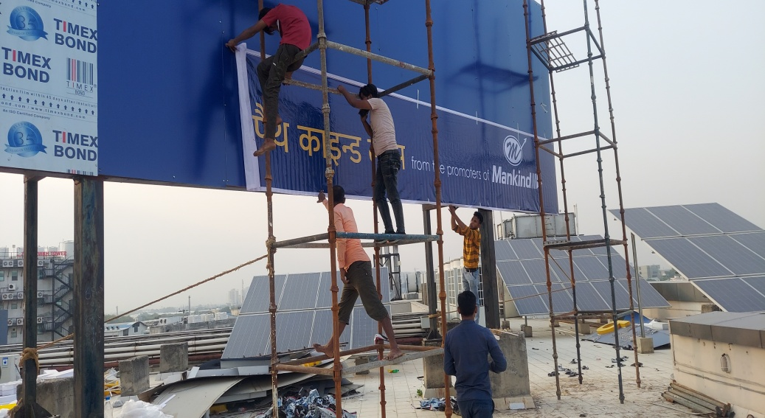
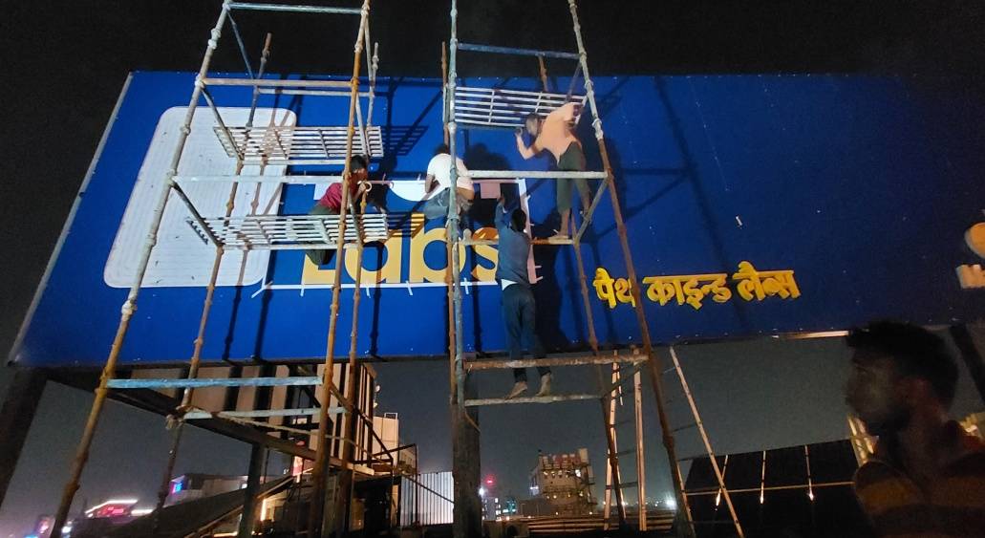
Main Signage Logo & Letter Installation image

Slide 14

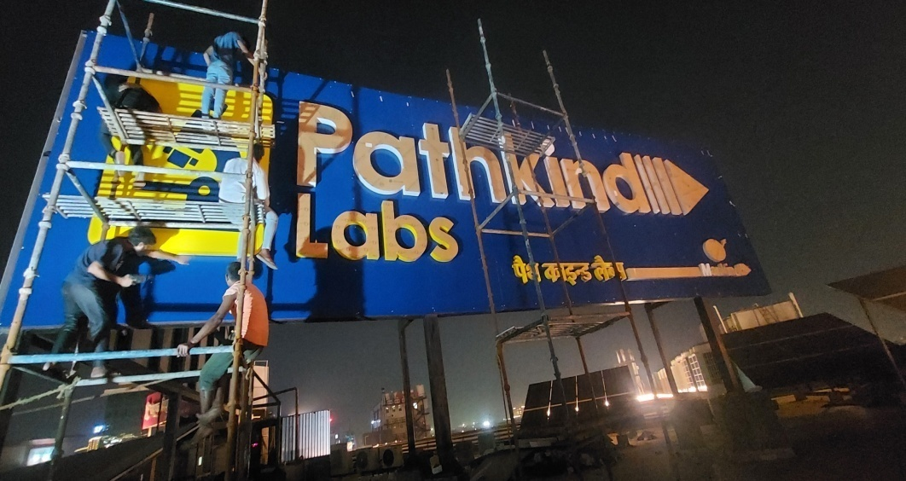
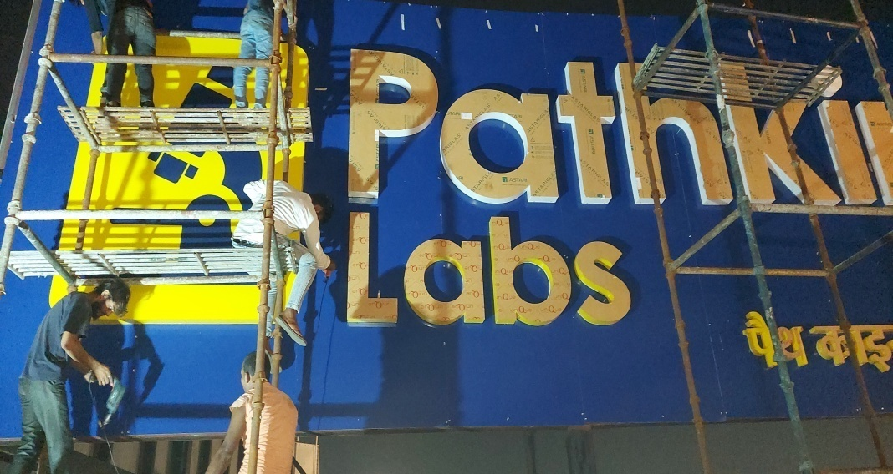
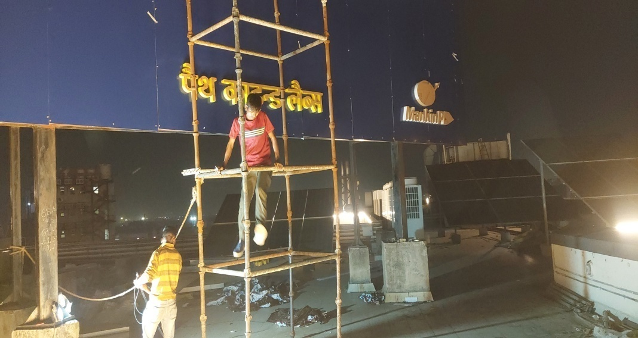
Main Signage Logo & Letter Installation image

Slide 15
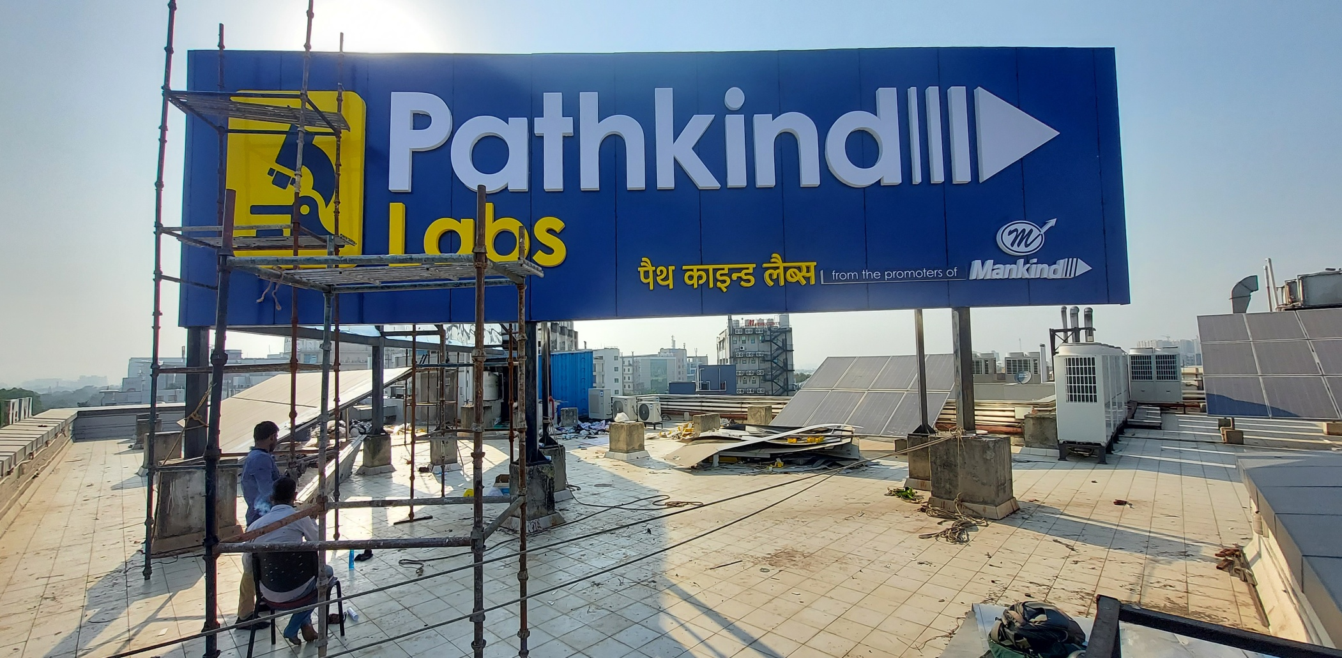
Main Signage Logo & Letter Installation Final image

Slide 16

Main Signage Logo & Letter Installation Final image

Slide 17

Main Signage Logo & Letter Installation Final image

Slide 18

Main Signage Logo & Letter Installation Final image

Slide 19


Slide 20


Slide 21


Slide 22

Night Image Main signage_Right Side 45 x 12 Feet

Slide 23

Night Image Main signage_Right Side 45 x 12 Feet

Slide 24

Night Image Main Signage_Left Side 45 x 12 Feet

Slide 25

Night Image Main Signage_Left Side 45 x 12 Feet

Slide 26

Night Image Main Signage_Left Side 45 x 12 Feet

Slide 27

Second Floor Signage 25 x 5 Feet_Night Image

Slide 28

Second Floor Signage 25 x 5 Feet_Night Image

Slide 29


Full Image of all lit signages

Slide 30

Full Image of all lit signages

Slide 31

Full Image of all lit signages

Slide 32

Full Image of all lit signages

Slide 33

Full Image of all lit signages

Slide 34

Full Image of all lit signages

Slide 35

Full Image of all lit signages

Slide 36

Full Image of all lit signages

Slide 37

Main Signage Logo & Letter Installation Final image with team

Slide 38


Handover old Suppy to
Maintenance Team

Slide 39




Cleaning the floor- working Area after
Work completion

Slide 40



SCRAP

Slide 41
Thank-you

